Slide 1




Ministry of Housing and Urban Affairs
Ministry of Social Justice and Empowerment
WebEx with State Nodal Officers
FOR NAMASTE SCHEME ON 19th SEPT’ 23
Implemented By
Knowledge Partners

Slide 2
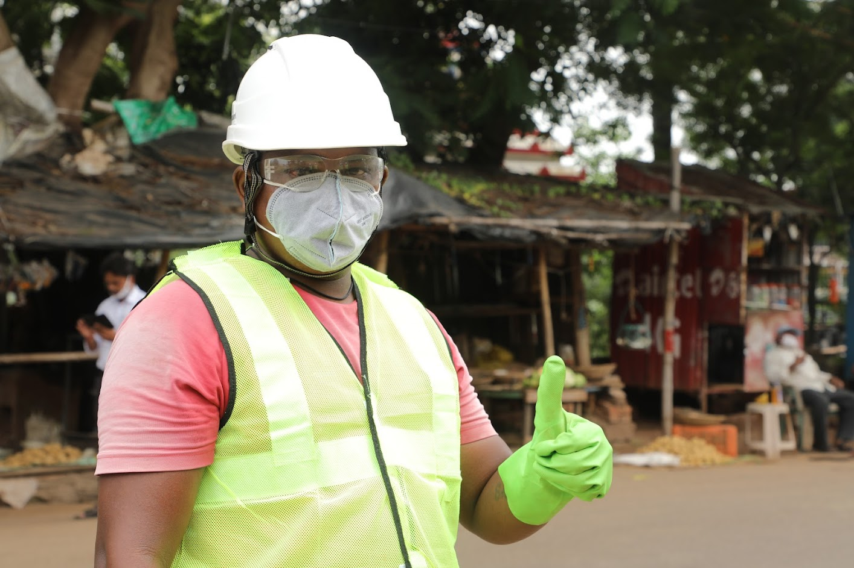
Content
About NAMASTE Scheme
Role and expectations from State for implementation of NAMASTE
Profiling Process of SSWs
State PMU Appointment

Slide 4


National Action for Mechanised Sanitation Ecosystem (NAMASTE)
A joint initiative of MoSJE and MoHUA
1
2
3
4
Ensure occupational safety and dignity of sanitation workers
Provide access to entitlements livelihoods support to reduce the vulnerabilities of sanitation workers
Behavior change amongst stakeholders to demand safe sanitation services
Mechanized cleaning of sewer lines and septic tanks
Aim
Target Group
Sewer and Septic Tank Workers (SSWs)
Stakeholders
MoSJE (NSKFDC) & MoHUA
Consumers of Sanitation Services
Sewer and Septic Tank Workers
Urban Local Bodies (ULBs)
Private Sanitation Service Organizations (PSSOs)
Septic Tank/pits Cleaners
Sewer network / maintenance holes Cleaners

Slide 5

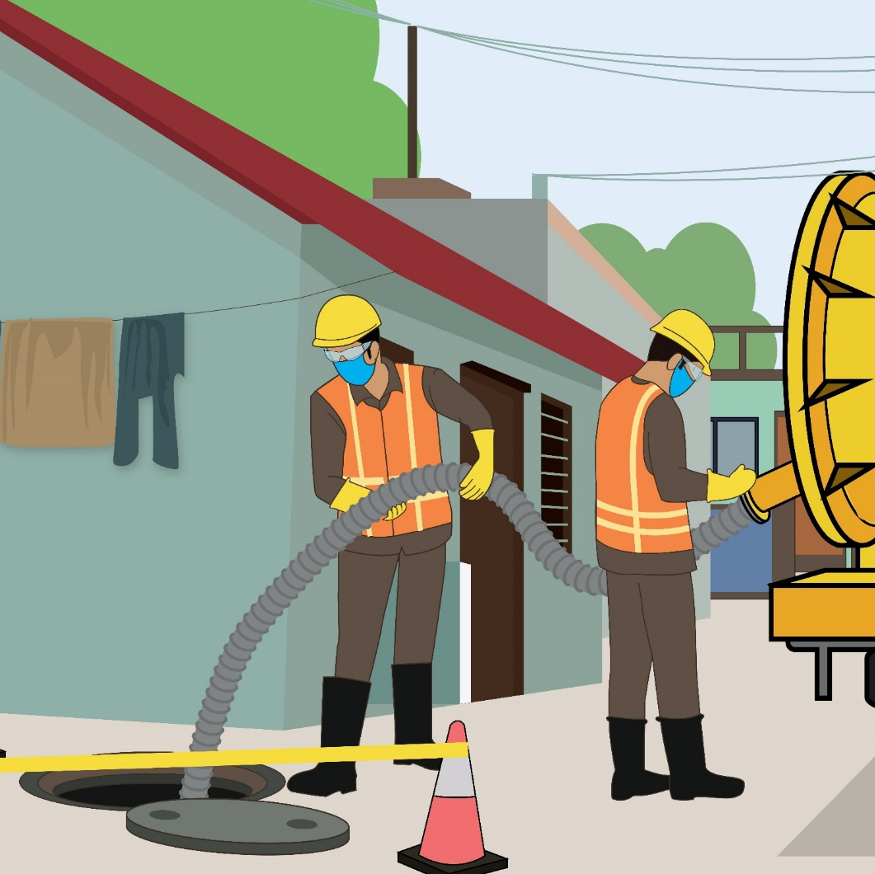





Intended Outcomes of NAMASTE
Zero fatalities in sanitation sector
No direct contact with human faecal matter
Recognition as skilled workers
Access to
livelihoods
SHG and sanitation enterprises formation
Increased awareness among citizens
Regulation and Enforcement

Slide 6

NAMASTE Components
Profiling of SSWs in ULBs through digital tools (~ 1 lakh SSW to be identified)
Health Insurance of SSW under PM-JAY
Occupational safety training of SSWs and SRUs for NAMASTE
Capital Subsidy up to Rs. 5.00 lakh and interest for procurement of Sanitation Related Vehicles/ Equipment
Distribution of PPE to SSWs
Distribution of safety devices to ERSU
IEC Campaign for awareness on SSW safety and dignity
State NAMASTE Coordinators: States/UTs would be authorized to engage PMU staff to support the Mission Director of State for implementation of NAMASTE scheme.
IT infrastructure: Dedicated NAMASTE portal for scheme implementation and monitoring.

Slide 7
Convergence Of Programmes Of Ministries
MoSJE
MoHUA
DoDWS
DPIIT
Profiling of Sewer and Septic tank workers in camp mode through ULBs
Sensitisation of ULBs for implementation of NAMASTE and follow up
IEC campaign in rural and urban peripheral areas to use services of SRUs convergences of ideas.
Identification of potential startup in sanitation sectors
PPE kit for surface sewer/septic tanks workers.
Provide Data on SSWs and PSSOs at ULB level for profiling
Promotion among startups for innovation in sanitation sectors
New technologies for tough terrains have been used as pilots in States like MTU for onsite desludging of septic tanks.
Safety devices and equipment procurement
Ensure nomination of RSA in each District.
Ensure setting up of SRU in each large ULB.
Occupational safety training and skilling of surface sewer/septic tanks workers.
SBM(G) Guidelines- States/districts to ensure mechanized desludging only
SHG formation of sewer/septic tank workers
Providing work assurance to sanitation workers for Sanitation Related Projects.
Provision of health insurance under AB-PMJAY
MSDE
Nomination of Mission Directors (SBM) as State NAMASTE Nodal Officer at State level/ULB level.
IEC Campaign
Occupational safety training of surface sewer / septic tank workers. MSDE to integrate with PMKVY.
Monitoring of implementation.
Training of sewer entry professionals and SRU staff. PPE for sewer entry professionals.
Coordination with MoHUA and other Ministries.
IEC in ULBs.
NAMASTE interventions to be evaluated under Swachh Sarvekshan

Slide 8
Role of State Government
Constitute working group at State Level and District Level for implementation of NAMSTE Scheme.
  Appointment of District Collector as RSA in each District.
State NAMASTE Nodal Officer may engage State PMU Coordinator who will assist them for effective implementation of NAMASTE .

Slide 9
Role of State NAMASTE Nodal Officer
Monitoring the implementation of NAMSTE scheme in the state.
  Ensure appointment of RSA and establishment of ESRU
  Appointment of State PMUs as per allocation and provide the details to NSKFDC. Guidelines for appointment PMUs has been shared to Principal Secretaries of States/ UTs.
Nomination of ULB level Nodal officer in each ULB for implementation of NAMASTE.
Facilitate the process of submission of a city profile through google form link to NSKFDC for all ULBs in the state.
*the responsibility of the State NAMASTE Nodal Officer is allotted to the designation and not the person.

Slide 10
Expectations from State
S. No | Activity | Timeline
1 | Online orientation (WebEx) of enumerators/surveyors of ULBs for conducting profiling of SSWs | 25th September 2023 onwards
2 | Appointment of State Level PMU (Status: Only Assam, Odisha, Rajasthan(1 out of 2) and Maharashtra(1 out of 2) have appointed. Confirmation awaited from other States/UTs.) | 30th September 2023 to be completed
3 | Conducting first profiling fortnight for SSWs | 1st October – 15th October 2023

Slide 11
PROFILING PROCESS OF SSWs

Slide 12
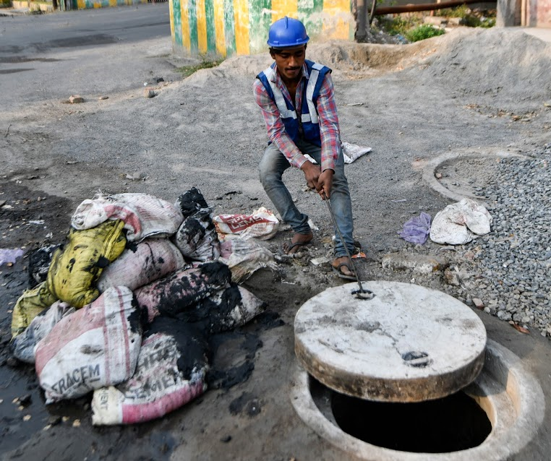
Why Profiling of SSWs?
The objective of the profiling camp is to
identify Sewer and Septic Tank Workers (SSWs) who directly deal with faecal matter
We have the constitutional mandates, legislations, Supreme Court orders and Human Rights Commission Directives
Yet,
the invisibility of sanitation workers continues…
Inclusion of sanitation workers is not possible if we do not have a robust database of workers

Slide 13
Challenges of SSWs
Social Issues:
Lack of identity and formal recognition of sanitation workforce
Lack of awareness and sensitivity for sanitation workers safety among citizens
Discrimination in society
Lower Literacy levels and lack of opportunities for skill enhancement
Economic and financial:
Lack of skilling and alternate livelihoods opportunities
Financial indebtedness
Lack of Transparency:
Poor contractual mechanisms and lack of SOPs in local governments
Lack of convergence amongst stakeholders for enforcement
Occupational Hazards and Health Issues:
Insufficient health and safety measures leading to injury, infection, eye sight, skin & respiratory diseases, mental health issues and death even before reaching the age of retirement
Intolerable working environment leading to substance abuse
Social Issues
Economic and financial Issues
Lack of Transparency
Occupational Hazards and Health Issues

Slide 14
Role of ULBs in Implementation of NAMASTE
Profiling of SSWs engaged by ULBs, parastatal agencies, PSSOs, state-level departments, private contractors through profiling camps
  Occupational safety training of SSWs in usage of PPE, safety devices and handling mechanized cleaning operations
  Formation of self help groups (SHG) of SSWs for sanitation related livelihood activities
Linkages to social and financial entitlements
  Linkages with livelihoods through SUY scheme for procurement of sanitation related machines and provide continuous work assurance

Slide 15
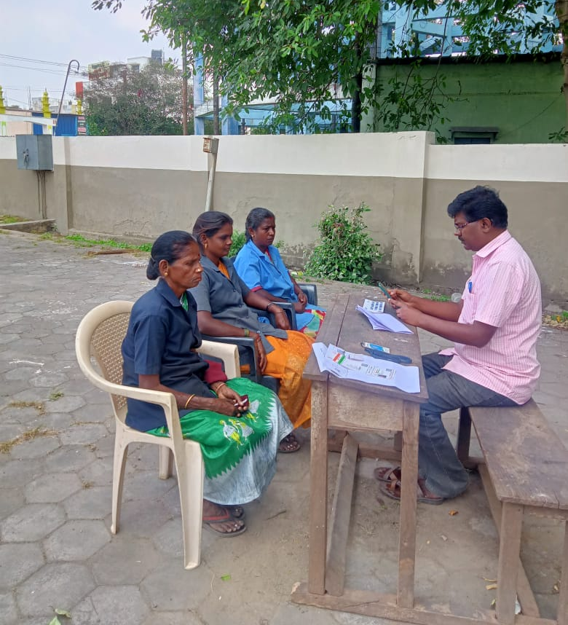
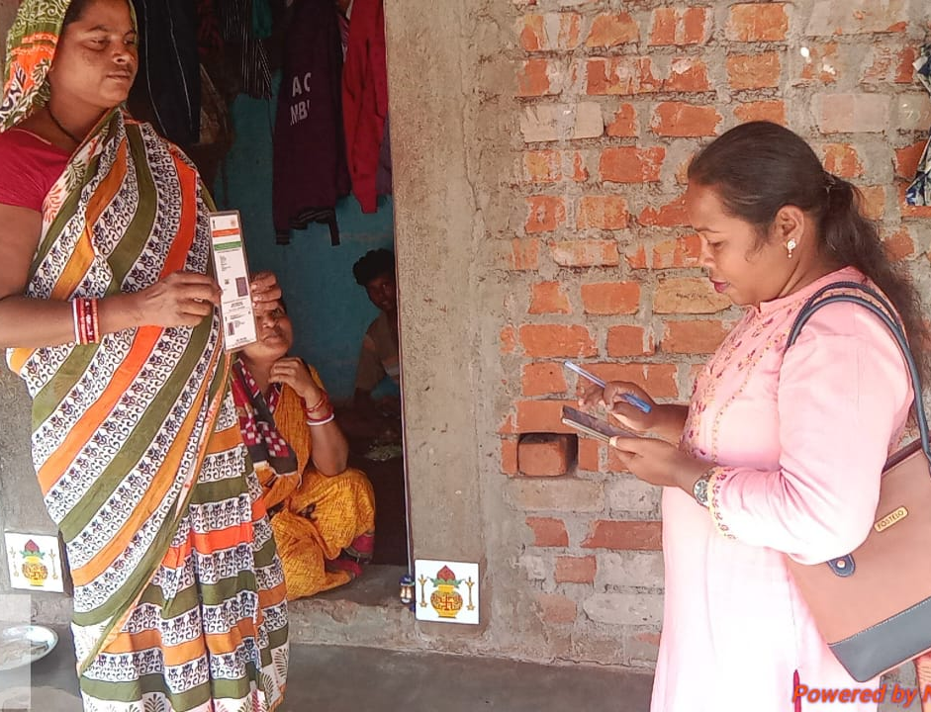
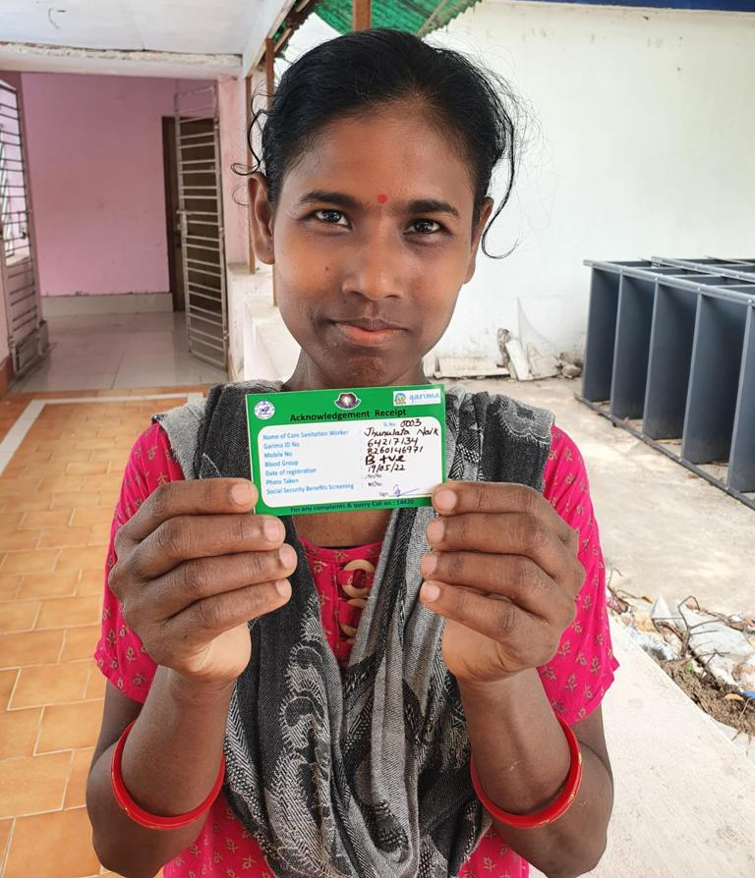
Profiling Process Flow
Enumeration of the SSW by enumerators
Validation of the Survey
By ULB level NAMASTE Nodal Officer (100%)
Generating the Unique ID of the SSW
Quality Check of the Survey by NSKFDC/PMU

Slide 16
Role of ULB in Profiling of SSWs
Organize City-Level NAMASTE Camps for enumeration of SSWs engaged by ULBs, parastatal agencies, PSSOs, state-level departments and other private contractors
Activities at Pre profiling Stage
Where?
Organize profiling camps at ULB offices (ward/ zonal/ central offices or at muster station) or in settlements where majority of SSWs reside.
How?
Enumeration through NAMASTE Application/Desktop portal
A collated list of SSW engaged by ULBs, Parastatal agencies, PSSOs, state-level departments and other private contractors
Submit City Profile and Identification of NAMASTE Nodal Officer at city level and Enumerators (Enumerators can be sanitary inspectors, SBM field level staff with digital literacy )
Training of NAMASTE Nodal Officer and Enumerators
Seek support from State NAMASTE Project Implementation Unit (PIU) to onboard State level parastatal agencies
Determine the number of camps based on population of ULB; extent of sewerage network, and number of septic tanks and distribution of SSWs in the city.
1 enumerator should survey 10 SSWs per day.
Issue notification for mandatory attendance of SSWs in camp and share it with parastatal agencies and PSSOs.
Budget of the camp: The admissible cost of conducting these camps is Rs.2000 for every 25 SSWs enumerated.
  When?
  Schedule camp at a time which is convenient to the SSWs and PSSOs to attend and does not impact their wages for the day.

Slide 17
Role of ULB in Profiling of SSWs
Checklist
 | INFRASTRUCTURE
 | Waiting Area for workers, which is well-lit, has proper ventilation and have breathing space.
 | Waiting area to be furnished with chairs, benches or carpet, for convenience
 | Separate space for the profiling
 | RESOURCES
 | List of SSWs employed on the payroll, contracts and through parastatal bodies and departments to be available for reference.
 | Survey Counter
 | Registration desk with the list for SSW attendance
 | Kiosks for Aadhar updation and for opening back accounts etc
 | Refreshments like Tea/ coffee to be provided
 | TECHNICAL
 | List of surveyors and validators available for the camps
 | Training of all surveyors and validators on survey questionnaire to be completed before the camps.
 | Surveyor and validator user IDs as per the guidelines to be created and tested before the camps
 | Internet connectivity to be readily available for the duration of the camps
 | Desktops and mobile phones to be made available for the duration of the camp. All desktops to include Webcams and scanners for the profiling.

Slide 18
Role of ULB in Profiling of SSW
IEC at Pre profiling Stage
Information, Education & Communication (IEC)
  Audio announcements, distribution of pamphlets near settlements, WhatsApp information, interpersonal communication through sanitation workers, supervisors, contractors etc.
IEC on NAMASTE Scheme benefits for SSWs such as health insurance, access to soft loans, trainings etc.
IEC on specific information of the date, location, and timings of the camp.
IEC on document required for camp: Aadhaar card or in the absence of it, any other government recognized photo ID such as Voter ID, ration card, PAN card, driving license, bank passbook, caste certificate, etc.
A profiling camp under ‘NAMASTE’ Scheme will be organized on [Date] at [Location] by [Name of ULB] for collecting details of sanitation workers engaged in cleaning and maintenance of sewer and septic tanks. You are requested to facilitate all the sanitation workers engaged with/by you directly or indirectly to the camp and allow them to attend the camp without cutting their wages for the day.
[Authorised person]
[Name of ULB]
Sample WhatsApp message for PSSOs/ SHGs

Slide 19

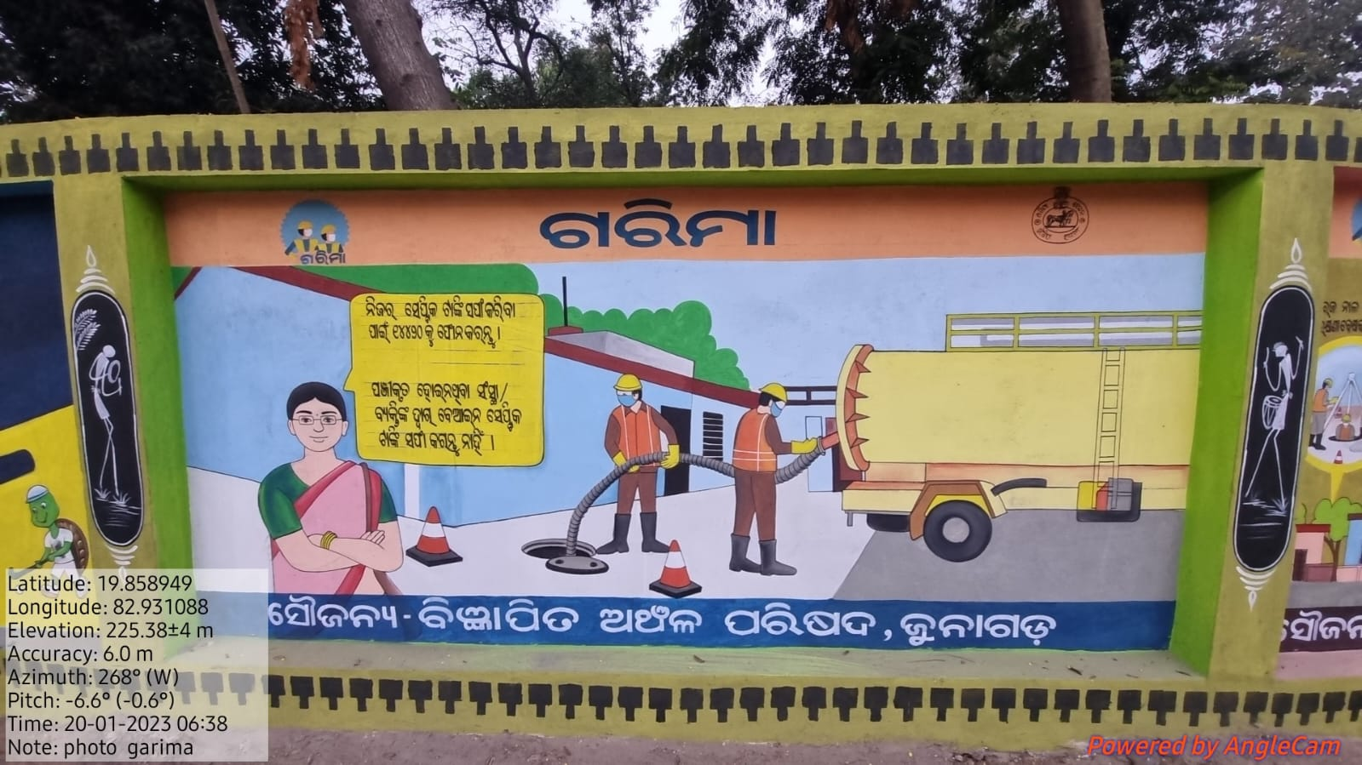

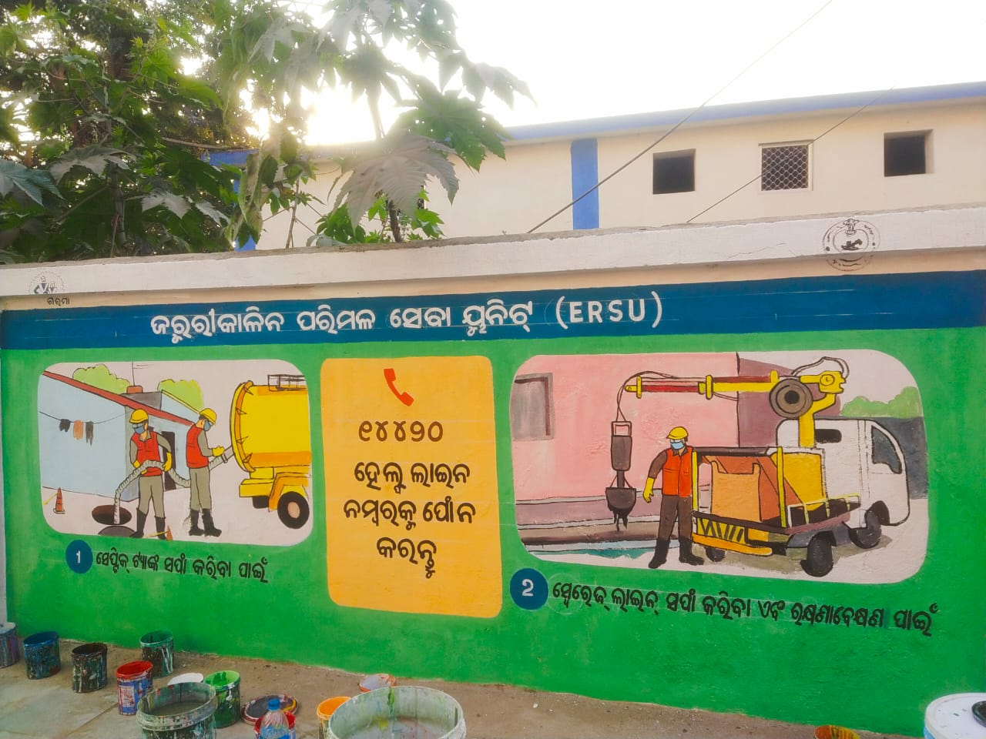
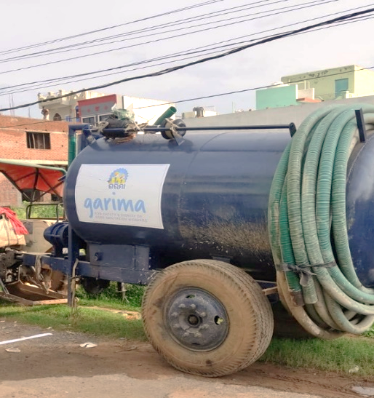
Role of ULB in Profiling of SSW
IEC examples for implementation by ULBs
Suggested Banners for NAMASTE
Wall Paintings for NAMASTE
Displays in Municipal Offices
Suggested Banners for NAMASTE
Wall Paintings for NAMASTE
IECs on vehicles/ Machineries

Slide 20
Role of ULB in Profiling of SSW
On the Day of the Camp
Readiness for the camp as per checklist
ULB has to fulfill the criterias of the checklist before the commencement of profiling camp.
Arrangement of adequate infrastructure
Internet connectivity
Electricity connection and charging points for mobile phones and desktops/laptops
Web-cams for desktop; document scanner for uploading documents and images on the NAMASTE web portal
Seating arrangements for enumerators and the SSWs
Provide refreshments (such as drinking water, tea/ coffee, etc.) for the SSWs and camp staff.
Basic amenities: Access to toilets, shade, fans etc.
Trained surveyors equipped with android mobiles or Windows-based PCs with created and tested user IDs as per checklist.

Slide 21
Role of ULB in Profiling of SSW
On the Day of the Camp
Ensure that enumerators follow guidelines for facial image capture of the SSWs.
Display informative IEC materials to educate SSWs about the NAMASTE scheme, their rights, and available entitlements.
Counters to be set up at the Camp
Registration
Counter
Survey
Counter
ULB may facilitate bank kiosks for opening bank accounts or Aadhaar centers for facilitating Aadhaar Updation, etc.

Slide 22
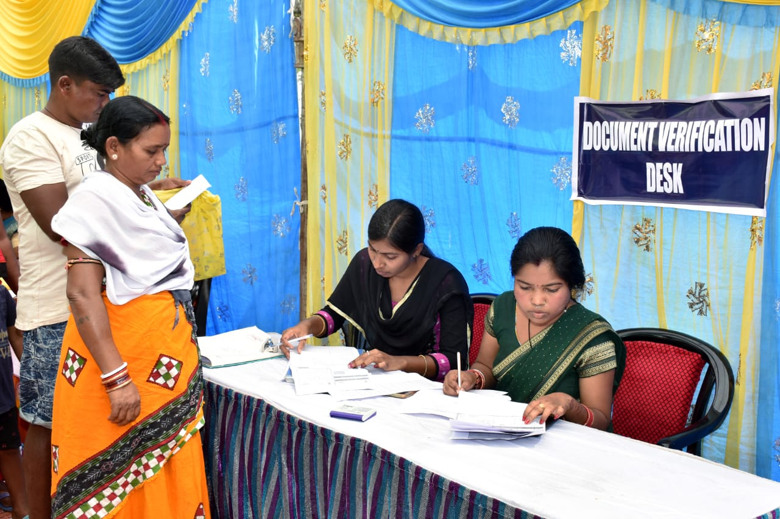
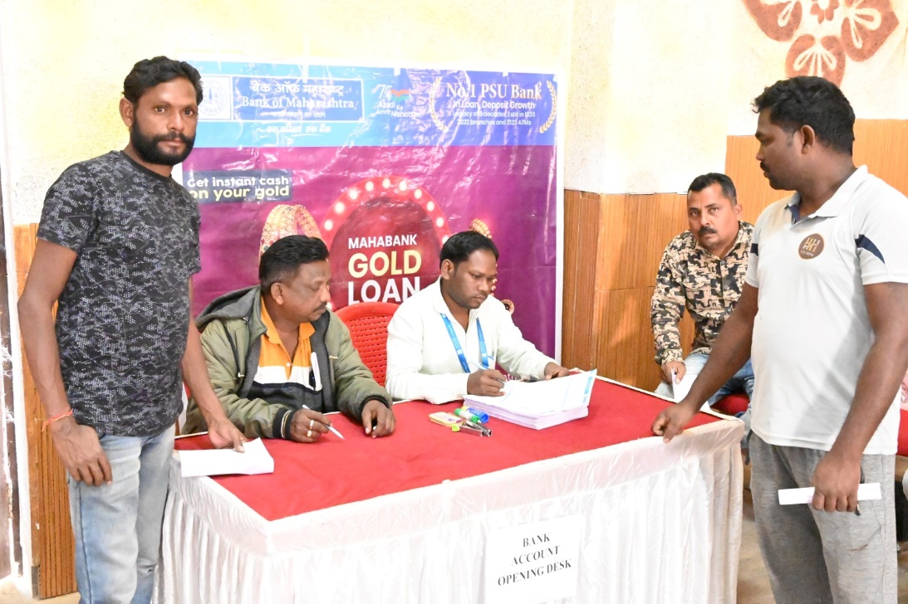
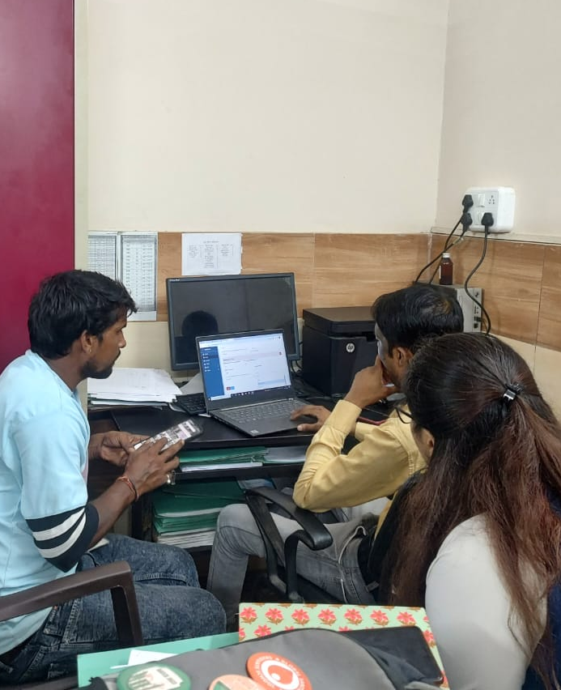
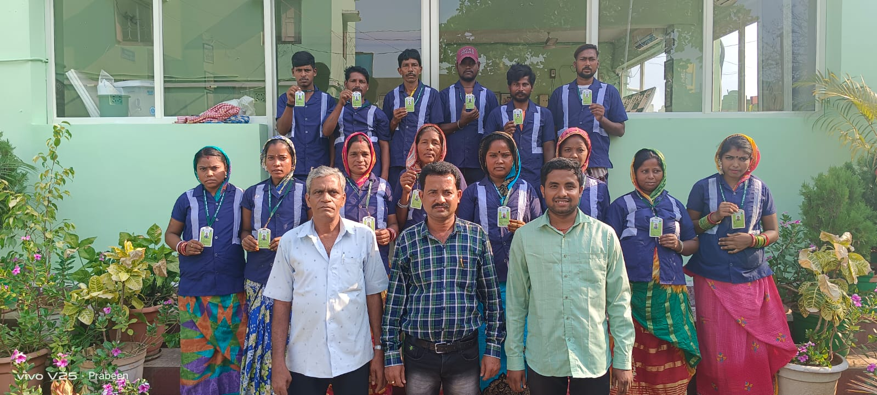
Role of ULB in Profiling of SSW
Activities at the Profiling Stage
Document Verification Counter
Bank Account Opening Desk
Enumeration Counters
ID card distribution to the identified sanitation workers

Slide 23
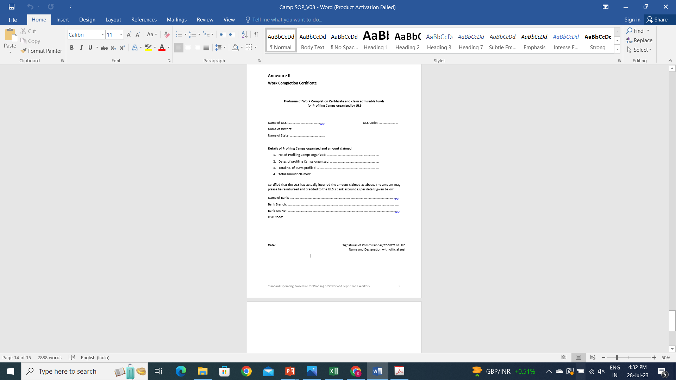
Role of ULB in Profiling of SSW
Activities at Post- Profiling Stage
ULB NAMASTE Nodal officer
should submit ‘Work Completion’ Certificate after organizing camps to claim reimbursement of up to INR 2,000 per 25 SSWs profiled on the NAMASTE MIS
Maintain a camp report
Including venue, date, time, number of counters, and the list of attending SSW. Submit video footage and photos of the camp to NSKFDC through email at nskfdc-msje@nic.in .
Error Flagging
7 days
Error Resolving
7 days
Validation
7 days
If the list of Workers given by ULB have documents
(proceed with desk validation)

Slide 24
Pilot Profiling Camps

Slide 25
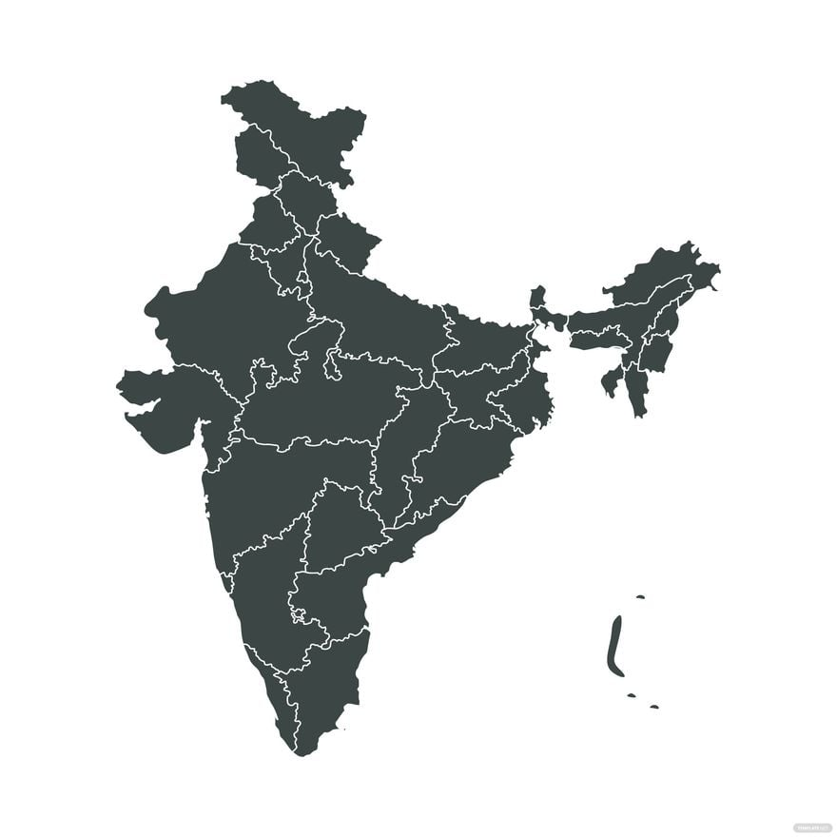

Pilot Profiling Camps
Dharamshala Municipal Corporation
PHED, Pataudi
Gurugram Municipal Corporation
Delhi Jal Board, Dwarka
Ghaziabad Nagar Nigam
Sanand Nagar Pallika
Gandhinagar Municipal Corporation
Guwahati Municipal Corporation
8 Pilot Cities
112
Total surveys
conducted
Total no. of SSWs Validated
: 9
Number of SSWs engaged in emptying of Septic tank
: 59
Number of SSWs engaged in Sewer line cleaning and maintenance
: 67

Slide 26
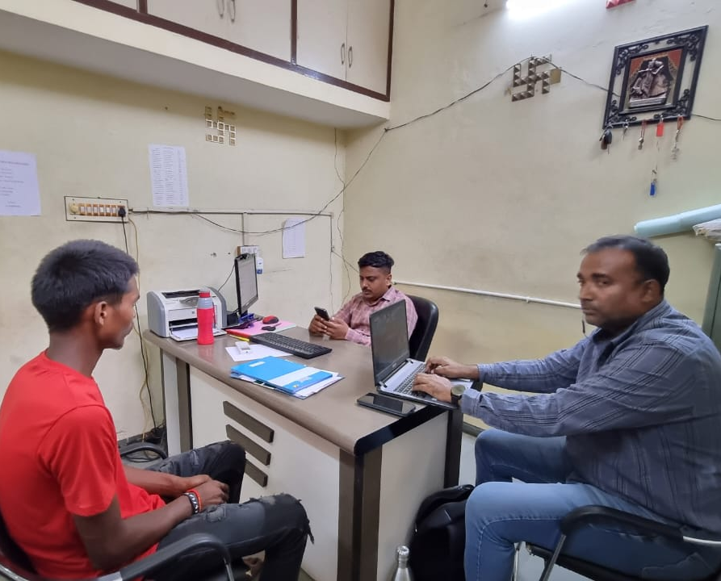
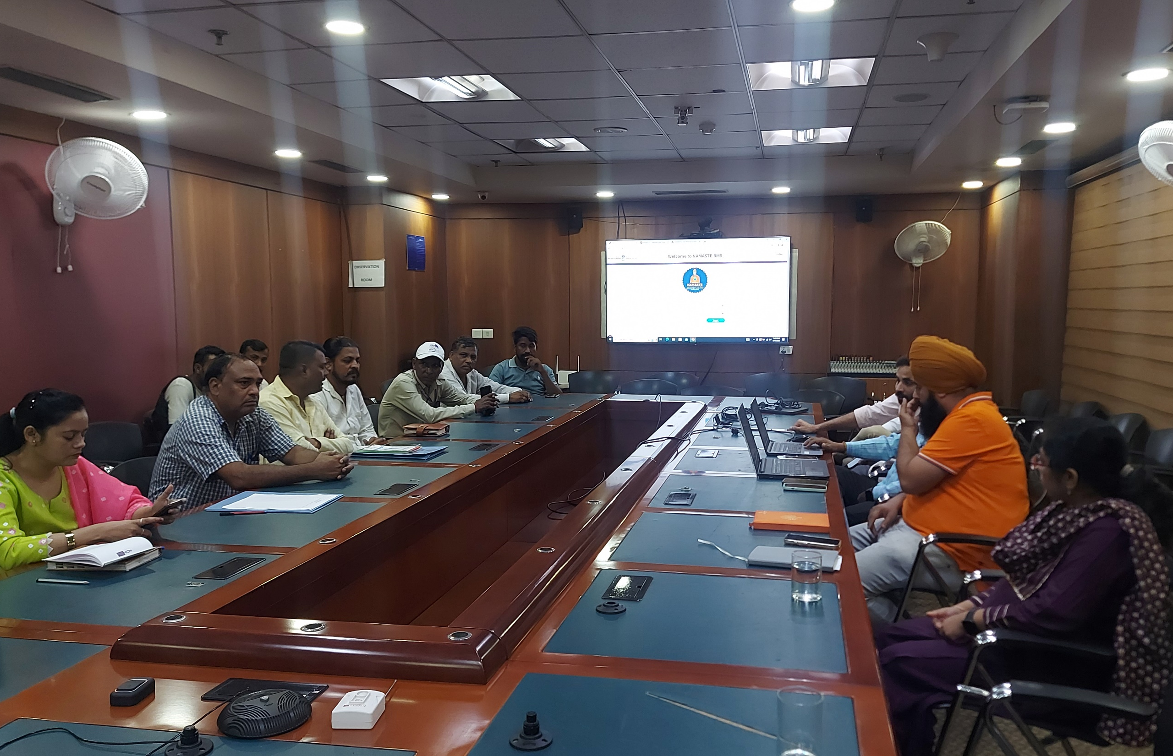
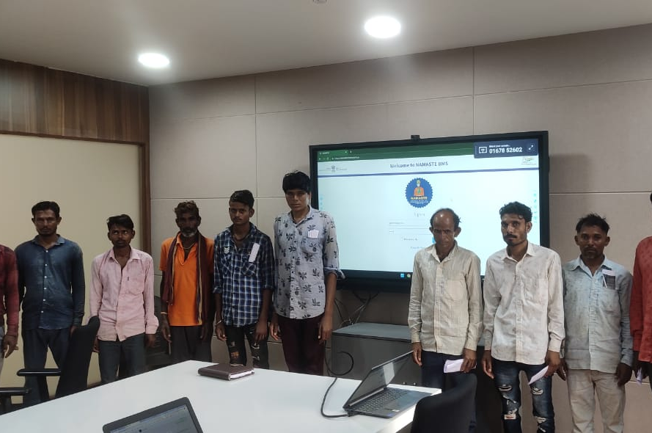
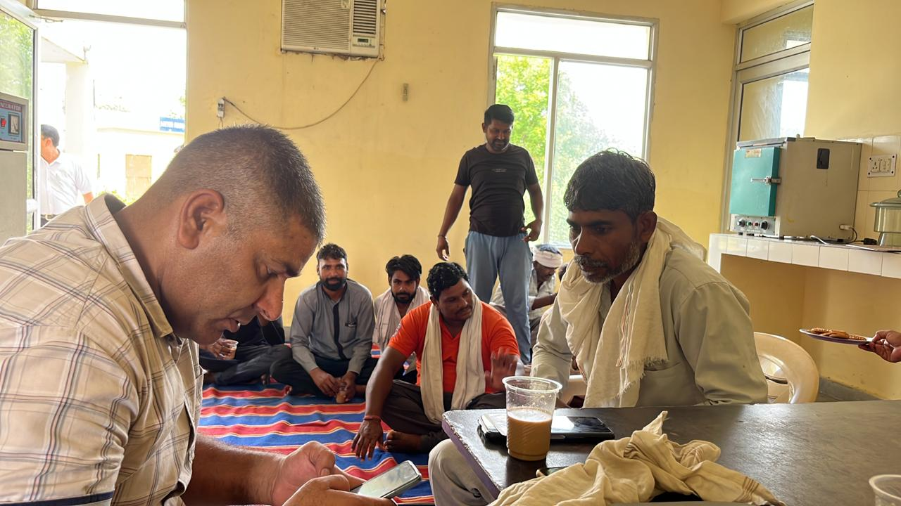
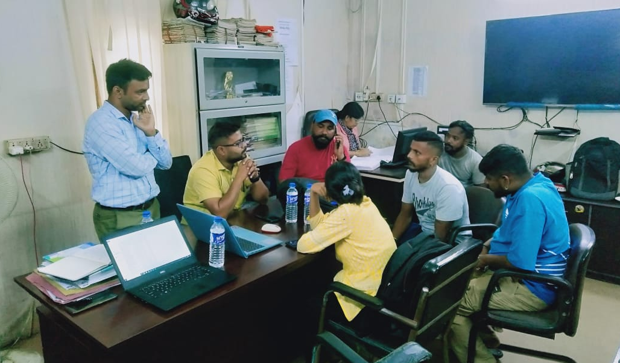
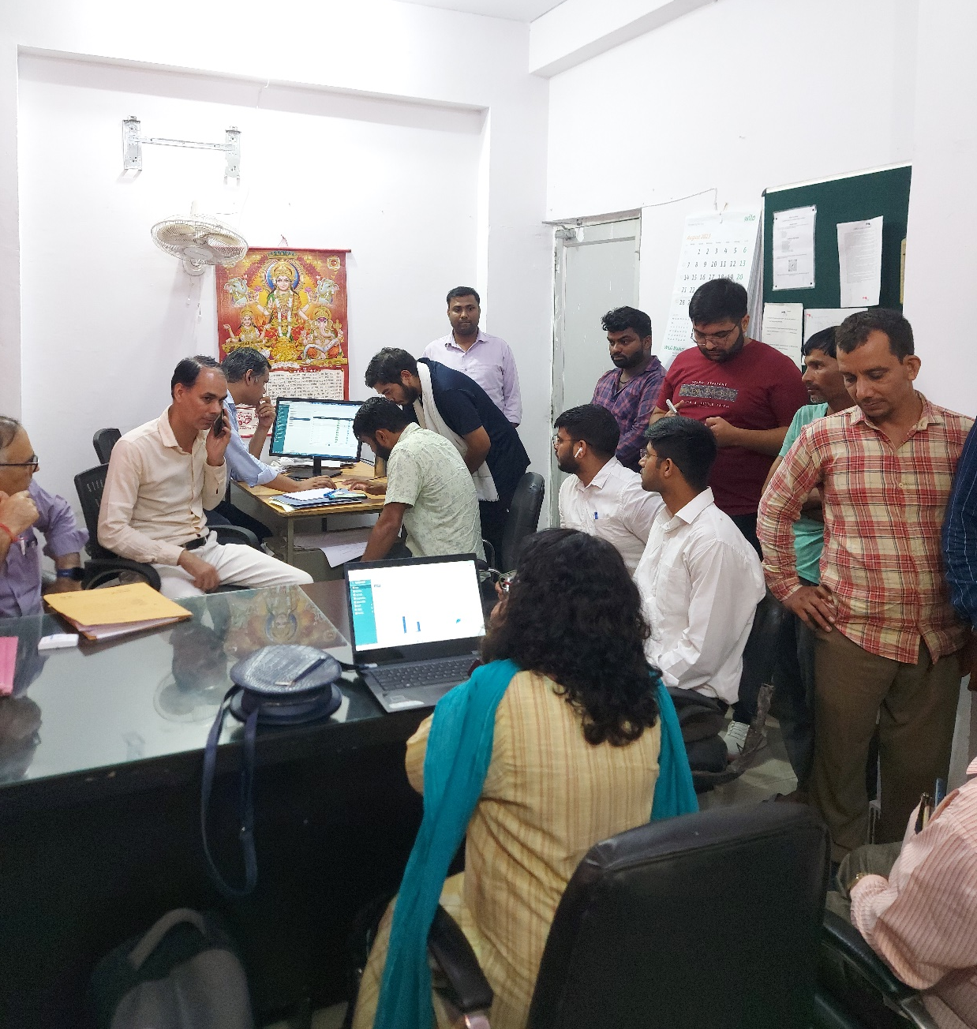
Pilot Profiling Camps

Slide 27
Key Takeaways
1
A helpline number is incorporated on the first page of the App for technical support.
ULBs should have a list of SSWs employed on their payroll, on contract, and those through parastatal bodies and departments before initiating profiling camps so that they can decide on number of enumerators to be trained and number of camps to be conducted for coverage of all SSWs.
2
3
A Demo Video of profiling of surveyor about questionnaire and nudges to questions so that they can understand the process of profilling, validators about error flagging and validation and nudges for error resolution.
4
The ULBs should be encouraged to use the mobile version of the App instead of desktop for smooth functioning in case of internet lapses and for the ease of clicking photographs of workers.
There needs to be coordination between Depts. such as PHED and ULB for conducting camps and the direction should come from State Nodal NAMASTE Officer in case of those cities whereby, the role of sewer and septic tank maintenance is divided between ULB and state depts.
5

Slide 28
Survey through the NAMASTE App

Slide 29
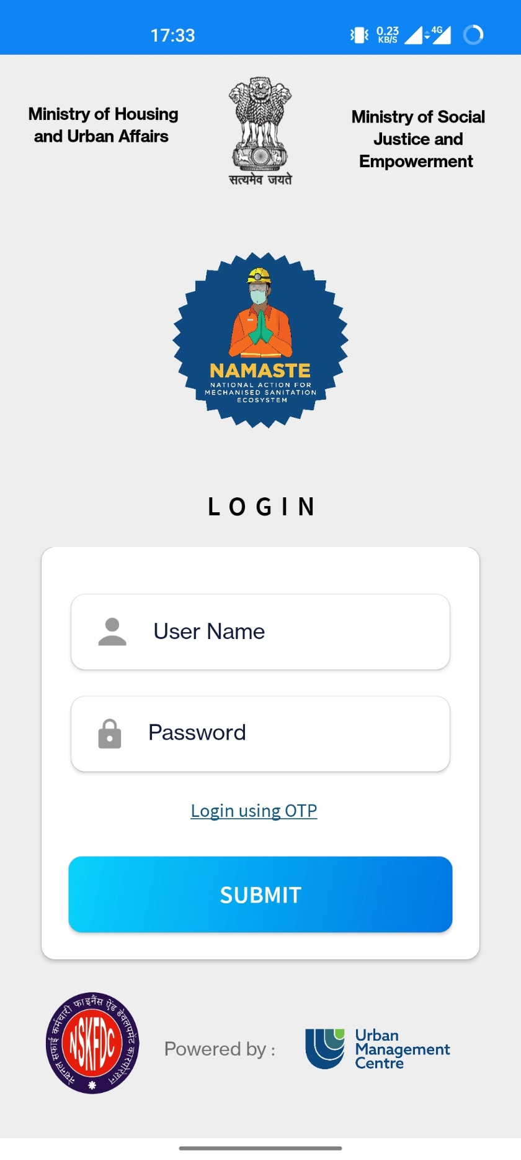
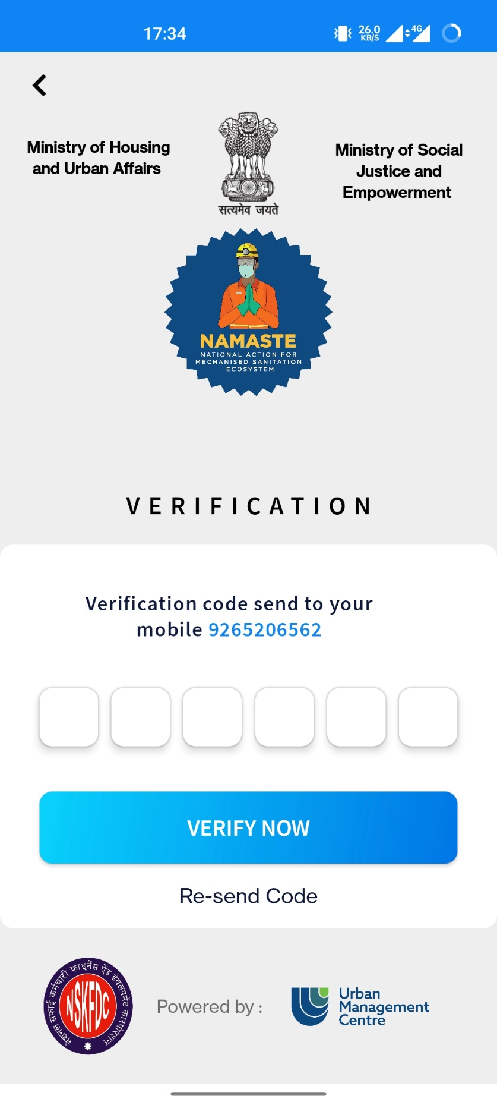
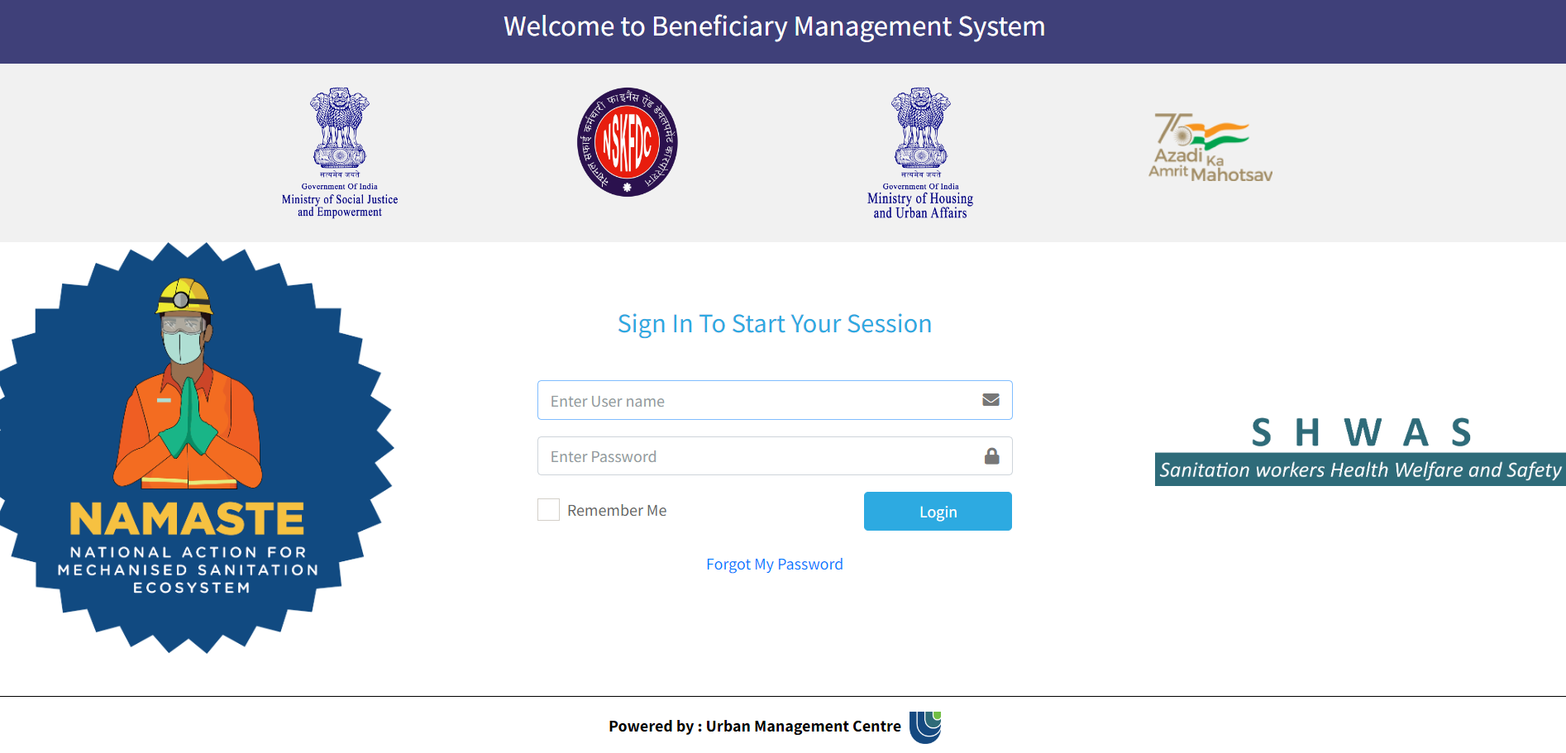
User interface
1
2
Mobile App Interface
PC Desktop Interface

Slide 30
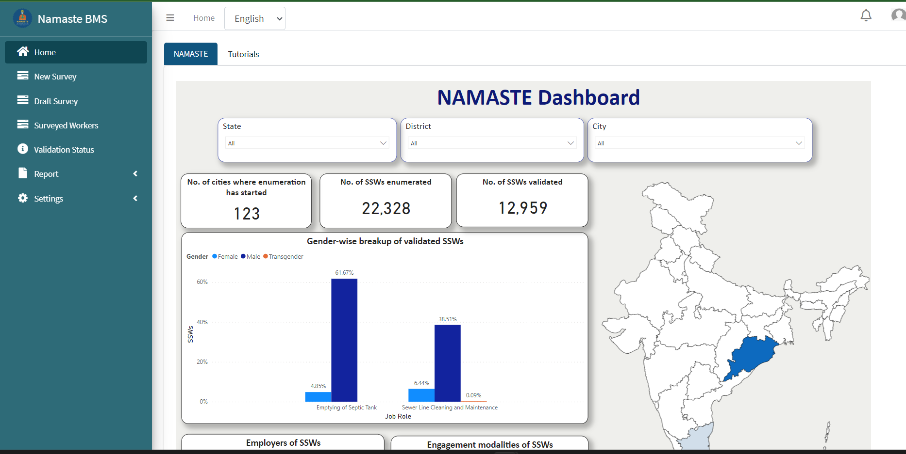
NAMASTE Dashboard

Slide 31
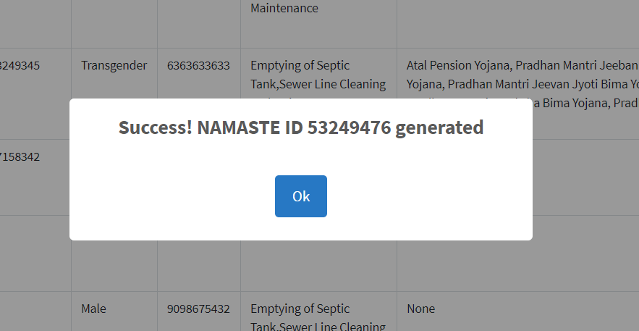
NAMASTE ID
Success message will be displayed based on the validation status of the worker

Slide 32
Appointment of State PMU

Slide 33
Status of appointment of State PMU
Sl. No. | States/UTs | No of ULBs | No. of PMUs
1 | ANDHRA PRADESH | 124 | 2
2 | ARUNACHAL PRADESH | 46 | 1
3 | ASSAM | 96 | 1
4 | BIHAR | 239 | 2
5 | CHATTISGARH | 169 | 2
6 | GOA | 14 | 1
7 | GUJARAT | 165 | 2
8 | DADRA & NAGAR HAVELI AND DAMAN & DIU | 3 | 0
9 | HARYANA | 91 | 1
10 | HIMACHAL PRADESH | 68 | 1
11 | JHARKHAND | 50 | 1
12 | KARNATAKA | 315 | 2
13 | KERALA | 94 | 1
14 | LAKSHADWEEP | 1 | 0
15 | MADHYA PRADESH | 411 | 2
16 | MAHARASHTRA | 418 | 2
17 | MANIPUR | 27 | 1
18 | MEGHALAYA | 10 | 1
19 | MIZORAM | 28 | 1

Slide 34
Status of appointment of State PMU
Sl. No. | States/UTs | No of ULBs | No. of PMUs
20 | NAGALAND | 39 | 1
21 | ODISHA | 114 | 1
22 | PUNJAB | 169 | 2
23 | CHANDIGARH | 1 | 0
24 | RAJASTHAN | 215 | 2
25 | SIKKIM | 7 | 1
26 | TAMIL NADU | 651 | 3
27 | A & N `ISLANDS | 1 | 0
28 | PUDUCHERRY | 5 | 0
29 | TELANGANA | 143 | 2
30 | TRIPURA | 20 | 1
31 | UTTAR PRADESH | 747 | 3
32 | UTTARAKHAND | 110 | 1
33 | WEST BENGAL | 129 | 2
34 | NCT OF DELHI | 3 | 1
35 | JAMMU AND KASHMIR | 80 | 1
36 | LADAKH | 2 | 0
 | Total | 4805 | 45

Slide 35
Roles and Responsibilities of State PMU
NAMASTE Scheme Implementation
  Coordinate with State NAMASTE Nodal officer and ensure the appointment of City level ULB nodal officer and SPOC for SUY scheme across the state ULBs.
  Assist the State NAMASTE Nodal Officer to track the progress of scheme component execution and identify potential bottlenecks.
Stakeholder Coordination:
  Act as the primary point of contact for NSKFDC to coordinate with State NAMASTE Nodal Officer, State Urban Development Dept., State Public Health Engineering dept., State Water and Sanitation dept., Parastatal bodies, ULBs and District Magistrates to ensure smooth implementation of scheme component such as organizing profiling camps for enumeration of SSW, distribution of PPE and Safety devices, issue of PM JAY cards, nomination of SSW for capital subsidy etc.
  Facilitate communication at state and district level in coordination with State NAMASTE Nodal officer and Ministry of Housing and Urban Affairs(MoHUA) for appointment of Emergency Response Sanitation Unit and Responsible Sanitation Authority

Slide 36
Roles and Responsibilities of State PMU
IEC and Public Awareness:
  Facilitate IEC such as workshops, training sessions, and awareness campaigns to promote safety and dignity of SSW
Project Monitoring and Evaluation:
  Monitor the progress of NAMASTE scheme component implementation at state and ULB level
  Act as the primary point of contact for City Nodal Officer for updating of NAMASTE MIS and ensure periodic reporting of NAMASTE scheme progress.
  Collect relevant data and information at state level and flag any issues in periodic reporting by ULB to NSKFDC
  Prepare regular reports on project progress, highlighting achievements, success stories and challenges with recommendations for improvement.
  Ensure that the project is implemented in accordance with the partnership agreement and in line with the Standard Operating Protocol of the MoSJE and Govt of India guidelines.
Capacity Building
  Coordinate with NSKFDC to ensure training of city level nodal officer and surveyors in NAMASTE profiling application for enumeration and periodic updation of NAMASTE MIS and Dashboard

Slide 37
Open Discussion

Slide 38
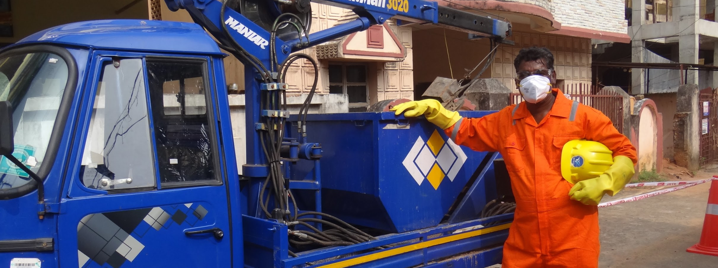
Thank you

