Slide 1
National Safai Karamcharis Finance and Development Corporation
Government of India
Ministry of Social Justice and Empowerment
Workshop on Prevention of Hazardous Cleaning of Sewers and Septic Tanks

Slide 2
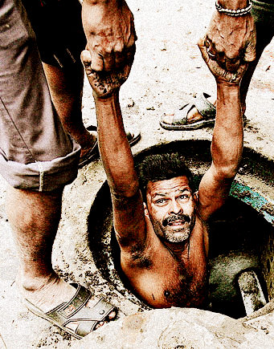
Topics to be covered
Manual Scavenging and Hazardous Cleaning in India
Legal provisions for the welfare of Manual Scavengers
Punishment as per MS Act 2013
Provisions regarding Hazardous Cleaning
Precautions to be observed for cleaning of Sewer and Septic Tank
Protective gear, safety devices and machines for cleaning of Sewer and Septic Tank
Schemes for rehabilitation of manual scavengers
Self-Employment Scheme for Rehabilitation of Manual Scavengers
Loan schemes of NSKFDC
Loan and assistance for sanitation related vehicles/instruments
NAMASTE Scheme

Slide 3
MANUAL SCAVENGING & HAZARDOUS CLEANING
Under the Prohibition of Employment as Manual Scavengers and their Rehabilitation Act, 2013 (MS Act, 2013)
3

Slide 4
Manual Scavenger definition as per MS Act 2013
Section 2(1)(g): “Manual Scavenger means a person engaged or employed, at the commencement of this Act or at any time thereafter, by an individual or a local authority or an agency or a contractor, for manually cleaning, carrying, disposing of, or otherwise handling in any manner, human excreta in an insanitary latrine or in an open drain or pit into which the human excreta from the insanitary latrines is disposed of, or on a railway track or in such other spaces or premises, as the central Government may notify, before the excreta fully decomposes in such manner as may be prescribed, and the expression “manual scavenging” shall be considered accordingly.”
A manual scavenger is a person engaged to manually clean, carry, dispose of, or otherwise handle in any manner, human excreta that is not fully decomposed.

Slide 5
Identification of Manual Scavengers
As per Sections 11 and 15 of the MS Act, 2013, if any Municipality or Panchayat has reason to believe that some persons are engaged or employed in manual scavenging within its jurisdiction, the CEO shall cause a survey to identify such persons
Accordingly, Ministry of Social Justice & Employment, piloted a nationwide survey, to be conducted by the concerned local authorities.

Slide 6
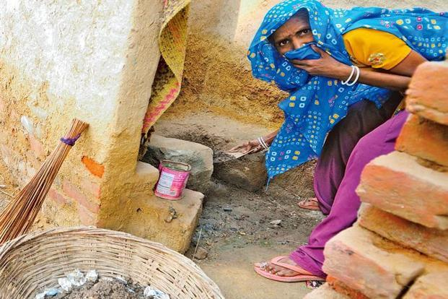
Types of Manual Scavenging
1
2
Cleaning of Dry Latrines
Toilet flushed into Open Drain
Notes:
Cleaning Of Dry Latrines
Manual Cleaning Of Pits
Cleaning of drains into which human excreta is flushes from insanitary latrines
Cleaning Of Railway Tracks

Slide 7
Types of Manual Scavenging
3
Cleaning of drains into which human
excreta is flushed from insanitary latrines
4
Cleaning of Railway Tracks
Notes:
Cleaning Of Dry Latrines
Manual Cleaning Of Pits
Cleaning of drains into which human excreta is flushes from insanitary latrines
Cleaning Of Railway Tracks

Slide 8
Eligible Manual Scavengers Identified under the surveys conducted by States under MS Act, 2013 and paid One time Cash Assistance of Rs. 40,000/- upto 31.3.2022
Total 58,098

Slide 9
Mobile App
Types of Manual Scavenging
Ministry of Social Justice and Empowerment had launched “SWACHHATA ABHIYAAN” Mobile App on 24.12.2020.
Capturing geotagged data related to any left out cases of insanitary latrines through citizens and volunteers/NGOs across the country
Twin Objective
Demolition of existing insanitary latrines (if any)
Rehabilitation of Manual Scavengers servicing the insanitary latrines

Slide 10
Hazardous Cleaning definition as per MS Act 2013
Section 2(1)(d): “Hazardous Cleaning” by an employee, in relation to a sewer or septic tank, means its manual cleaning by such employee without the employer fulfilling his obligation to provide protective gear and other cleaning devices and ensuring observance of safety precautions, as may be prescribed or provided in any other law, for the time being in force or rules made thereunder;
Hazardous Cleaning is manual cleaning of sewer or septic tank without proper protective gear and cleaning devices.

Slide 11
Health Issues associated with Hazardous Cleaning of Sewers and Septic Tanks
Cleaning
Carrying
Disposing
Hazardous Cleaning Involves
Health
Hazards
Partial Blindness
Skin Diseases
Deformed Spines
Prolonged
Hazardous Cleaning
Death

Slide 12
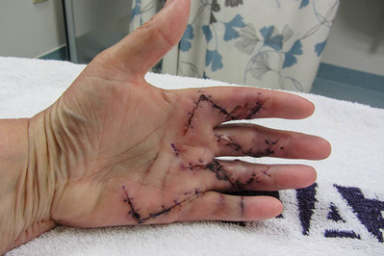
Types of Hazards
1. Physical Hazard
Injuries due to falls or slips
2. Health Hazard
Fungal/ bacterial diseases like Cholera, Typhoid, Hepatitis, etc. due to hand to mouth transmission
Icon source: 123rf.com, clipartmax.com
Image source: Creative commons

Slide 13
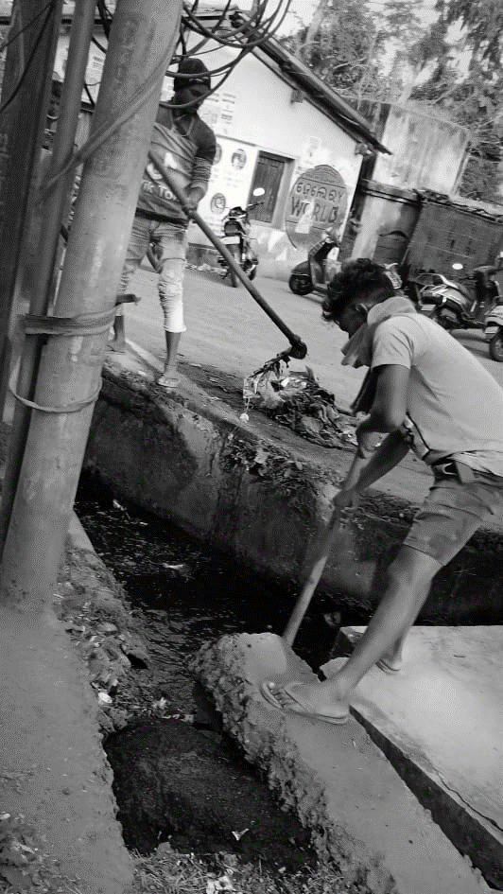
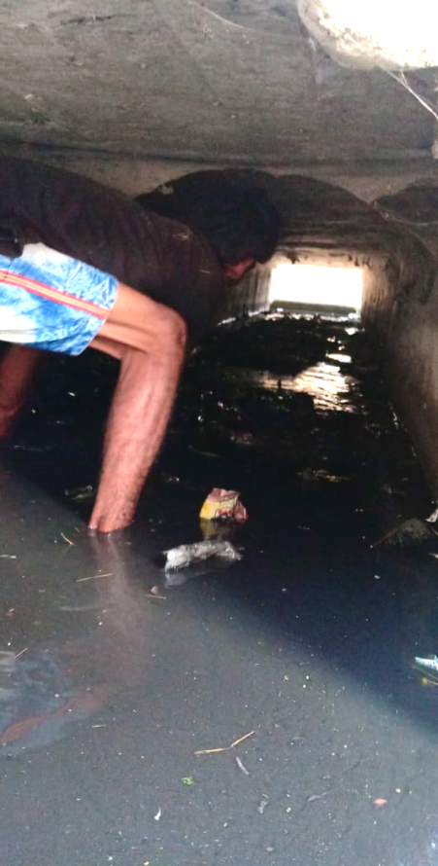
Types of Hazards
3. Gaseous Hazard
4. Electric Hazard
Choking / Suffocation
Chest pain/ Breathlessness
Electric shock in case of coming in contact to live wires can be prove fatal
Fainting
Icon source: 123rf.com, clipartmax.com
Image source: Creative commons

Slide 14
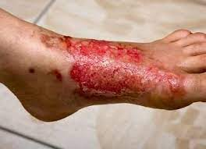
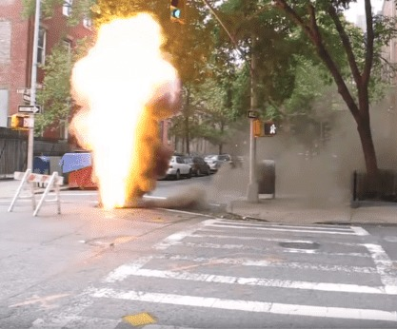
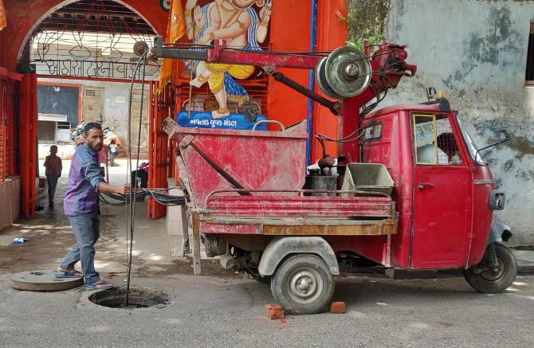
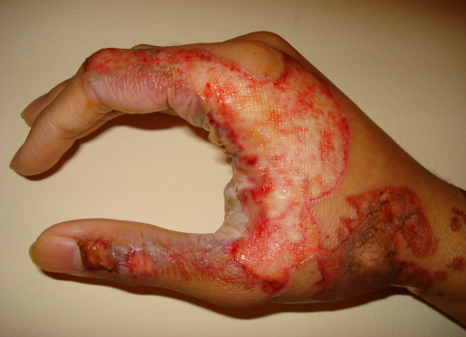
Types of Hazards
5. Fire Hazard
4. Electric Hazard
Severe burns can be fatal as well
Severe injuries while ill-handling of tools and equipment
Icon source: 123rf.com, clipartmax.com
Image source: Creative commons

Slide 15
Sewer and Septic Tank Workers (SSWs)
Workers who cleans, maintain, repair the chocking of sewer pipeline and its operations are called Sewer line workers/Sewerman
Workers who empty septic tank of resident, commercial, public and institutional premises are called Septic Tank workers
Sewer and Septic Tank workers
.
Workers employed through:
Urban Local Body (ULB) Payroll
Urban Local Body (ULB) Contractual
Private Sanitation Service Organization

Slide 16
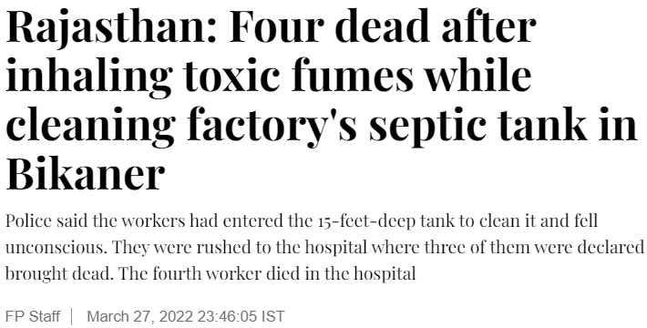
Sewer and Septic Tank Worker deaths due to hazardous Cleaning
Over 1000 Deaths of Sewer & Septic Tank worker since 1993
Major Cause of Death of Sewer and Septic Tank Workers
Asphyxiation, or suffocation
Inhalation of poisonous gases (Methane, Hydrogen Sulphide) in the sewer or septic tank
Drowning
Injury from falling of metal, concrete/heavy material/instruments
Falling , Slipping of sanitation worker
Electrocution
16

Slide 17
Places where Death occurred while cleaning Septic Tanks
Institutional
College
Schools
Coaching Institute
Sensitization of these authorities and users on hazardous cleaning of septic tanks are mandatory
Public Places
Public toilets
Park Toilets
Temples
Tourist sites
Residential/RWA
In-house
septic tank
Site of Incident
Commercial Place
Malls
Cinema Halls
Market Place
Hotels
Hospitals
Office buildings

Slide 18
Issues of Concern
Non Fulfillment of Obligations by Employer Under MS Rules, 2013
Non observations of safety precautions under MS Act/Rules
Death occurred due to violation of provision of the MS Act/MS Rules
Manual Cleaning of Sewers/septic tanks for routine cleaning
Inadequate Provision of Personal Protective Gear
No provision of Safety devices
No use of machines for cleaning Sewers and Septic tank
Not following Safety Precautions(testing poisonous gases, ventilation, etc.)
No insurance of SSW by employer
Rule 3(1)(e): Any circumstance, when it is absolutely necessary to have manual sewage cleaning, after the CEO of the local authority has permitted to do so after recording in writing the specific valid reasons for allowing such cleaning.

Slide 19
Issues of Concern
The existing underground sewerage system is not adequate and not standardized for mechanized cleaning
Un-sewered areas are serviced by septic tanks with no regulated mechanism for sludge cleaning and disposal
Engagement of untrained persons for manual cleaning of sewers and septic tanks without observing safety norms mandated under the “Prohibition of Employment as Manual Scavengers and Their Rehabilitation Rules, 2013
Non-observance of safety precautions by local authorities and contractors resulting in fatal accidents
No database of sewer/septic tank workers
There is no program to identify such workers, link them with livelihood interventions and provide benefits of other Social Security Schemes.
19

Slide 20
Legal provisions
Hazardous Cleaning of Sewers and Septic Tanks
16

Slide 21
Punishment for Hazardous cleaning as per MS ACT 2013
Punishment for 1st Time:
Fine Upto 2 years of Jail
Or Fine Upto Rs. 2 lakh
Or Both
Punishment for 2nd Time:
Fine upto Five Years of Jail
Or Fine upto Rs.5 lakh
Or Both
In a case filed by Safai Karamchari Andolan, Hon’ble Supreme Court of India has ordered to pay a compensation of Rs. 10 lakh to dependants of sanitation workers died while cleaning sewers/septic tanks since 1993
MS ACT 2013

Slide 22
Manual Scavenging (MS) Rules 2013
Considering the seriousness of the problem and to uplift the social and economical condition of the manual scavengers, the Government of India passed the the Prohibition of Employment as Manual Scavengers and their Rehabilitation Act, 2013 to ban manual scavenging in the country.
The Rules framed under the Act include 5 chapters as the following:
Chapter I - General
Chapter II - Obligation of Employer towards Employees
engaged in Cleaning of Sewer or Septic tank
Chapter III - Survey of Manual Scavengers
Chapter IV - Powers of the Inspector
Chapter V - State Monitoring Committee

Slide 23
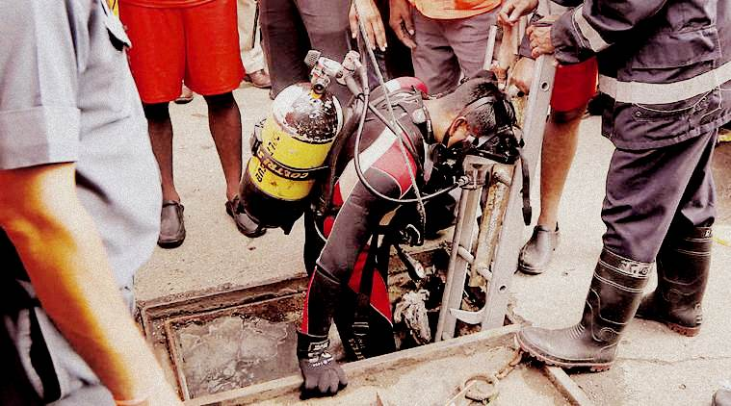
Manual Scavenging (MS) Rules 2013
Manual Scavenging (MS) Rules 2013
Chapter II covers the following points:
Obligations of employer towards employees engaged in the cleaning of sewer or septic tank
Conditions when Hazardous Cleaning is allowed
Protective gear and safety devices to be provided by employers for cleaning of sewer or a septic tank
Cleaning devices to be provided by local authority for cleaning of sewer or a septic tank
Safety precautions before, during and after a person is engaged in the cleaning of a sewer or a septic tank

Slide 24
Condition when Hazardous Cleaning is allowed
Cleaning of Sewer by a person (manually) is allowed, only with protective gear and safety devices….
For the removal of concrete or FRP (Fibre Reinforced Plastic) or damaged manhole door where mechanical equipment's cannot be put into operation
For inter-linking the newly laid sewer main with the existing sewer main, in case of sewer of size of more than 300 mm diameter
For removal of submersible pump sets fixed at the bottom of the suction wells
For the reconstruction of the manhole or rectification of the sewer main
Or when it is absolutely necessary to have manual sewage cleaning, only after the CEO of the local authority has permitted to do so after recording in writing the specific valid reasons for allowing such cleaning

Slide 25
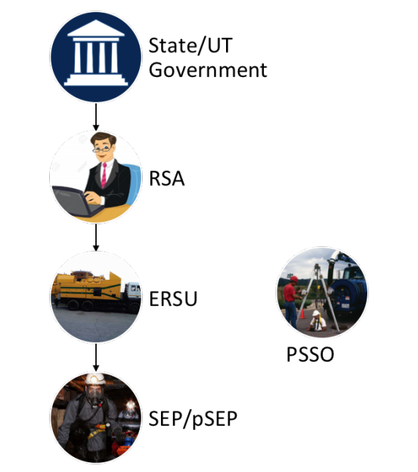
Formation of Emergency Response Sanitation Unit (ERSU)
For systematic human entry, an Emergency Response Sanitation Unit (ERSU) set-up should be implemented at the District/Municipal corporation
Objective of ERSU
Organogram of ERSU
Provide a professional, well-trained, motivated, and appropriately equipped workforce for the maintenance and management of sewers and septic tanks, thereby eliminating the deaths caused by the entry of workers into sewers and septic tanks without proper safety mechanisms
PPEs, Safety devices, and adherence to security protocols
Training and certification of SSW
Helpline number 14420 for making sanitation service requests
Duty supervisor ensures the availability of machines, PPE & safety devices

Slide 26
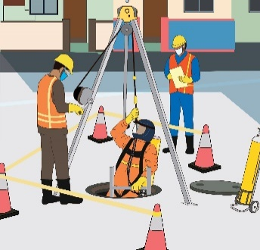
Objective of Responsible Sanitation Authority (RSA)
Headed by Responsible Sanitation Authority (RSA)
Provided with a toll-free helpline number- 14420
Salient features
RSA: Head of Parastatal Agencies/MC/EO
“Any human entry required into sewers/ septic tanks shall be undertaken by the ERSU only.”
Duty Supervisor: Functional in charge of ERSU at level of Executive Engineer/ Sanitary Inspector.
SEP:
Dedicated Teams of trained persons (engaged with ULB or empanelled PSSOs).
One SEP team to be maintained per 500 septic tanks/ 50 km of Sewer length
(i) Authorised Entrant- Two persons who is authorized to enter a S/ST.
(ii) Attendant - Stationed outside who monitors the authorized entrants and perform all attendant’s duties assigned in the SOP.
Notes:
ERSU ppt

Slide 27
Process Flow – Cleaning of Sewer Line/Septic Tanks through ERSU
Service seekers call on 14420
Duty Supervisor visits the site
In case of Mechanical Cleaning
Registered Helpline Number
Site assessment to determine whether mechanical cleaning is possible or human entry is required
Duty supervisor issues pre-printed ‘Command Certificate’ to the PSSO
In case mechanical cleaning is not possible
RSA grants written permission for manual entry after assessment of report
Submission of Assessment Report to RSA
SEP to sign a self declaration form consenting to undertake the job
Duty supervisor to inform the SEP of the risks and hazards of the job
Duty supervisor to inform the ambulance, police and fire service to ensure safety of SEPs

Slide 28
Role of Emergency Response Sanitation Unit (ERSU)
In Case of Manual Cleaning
In Case of Mechanical Cleaning
Duty supervisor prepares Hazard Assessment Report and submits to RSA
RSA provides permission for safe manual entry
Duty supervisor provides of PPE and Safety Devices
Gets Self declaration form signed by SEPs
Duty supervisor measures level of gases and takes action for Ventilating the confined space
Duty supervisor supervises entire process of entry
Submit completion report to RSA
Service seekers call on 14420
14420 operator records the request and informs the Duty Supervisor for inspection/ assessment
Duty Supervisor visits the site only if he/she gets request for manual cleaning in case mechanical cleaning is not possible
In case of Mechanical Cleaning: Duty supervisor issues pre-printed ‘Command Certificate’ to the PSSO/ ULB
Duty supervisor submits real time update in Whatsapp group of state and ULB official

Slide 29
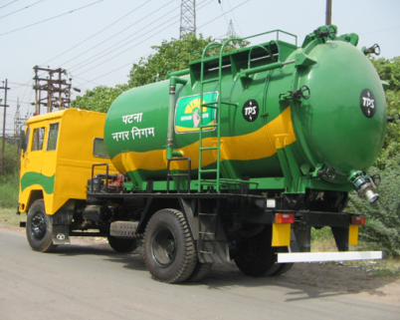
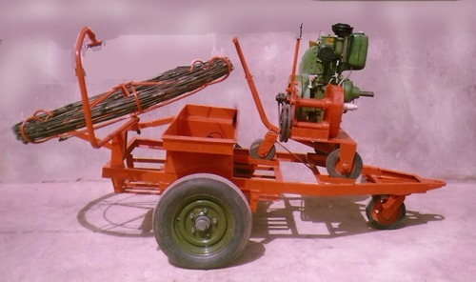
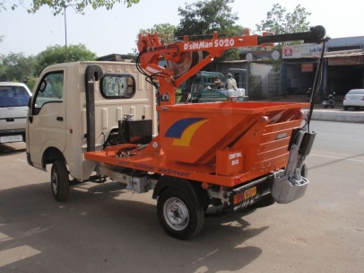
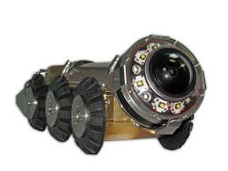
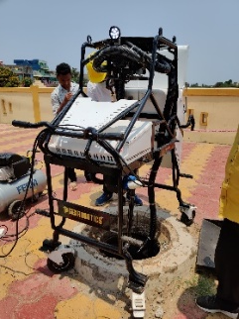
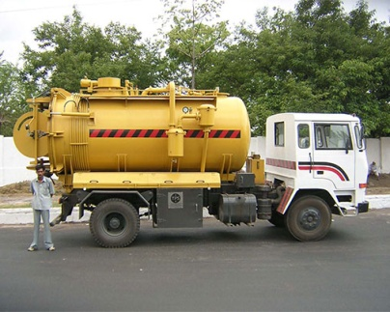
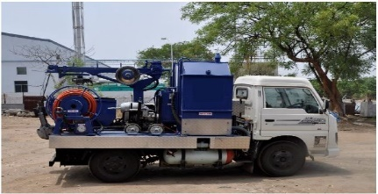
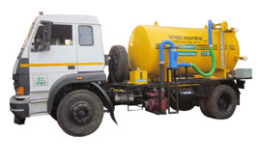
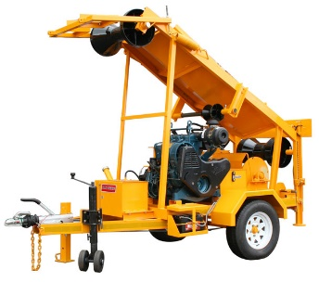
Sanitation Machines used for Cleaning of Sewers
Human entry should only be permitted in the Rarest, Unavoidable Situations/ large sewers
All necessary equipment and safety gear readily available in Indian Market and on GeM platform
Gully emptier (Suction machine)
Rodding Machine with Flexible Sewer Rods
Sewer cleaning robot
Grab bucket machine
Sewer Inspection Robot
Hydro jetting machine
Jetting, grabbing, rodding machine (combination)
Cesspool vehicle
Sewer cleaning bucket machine
Image sources: http://www.tpsmfg.com/liquid-waste-management.php
https://www.exportersindia.com/product-detail/sewer-rodding-machine-5010828.htm
https://www.maniars.in/products/d-siltman-/15
http://www.tpsmfg.com/high-pressure-sewer-jetting-machine.php
http://www.kamavida.com/products/kamjet-gr-on-lcv
https://www.exportersindia.com/product-detail/sewer-cleaning-machine-5010826.htm
Note: Pictures shown here are for illustration purpose only and do not endorse any brand or a product.

Slide 30
Precautions BEFORE, DURING and AFTER
cleaning of SEWER OR SEPTIC TANKS
21

Slide 31
Precautions BEFORE cleaning of sewer or Septic tanks
1
Before starting the cleaning, ensure that a supervisor has inspected and determine industries nearby to anticipate any hazardous atmosphere that may be encountered:

Slide 32
Precautions BEFORE cleaning of sewer or Septic tanks
2
The condition of metal-rung ladders and the side walls of the manhole shall be checked to see if there is any danger of collapse

Slide 33
Precautions BEFORE cleaning of sewer or Septic tanks
3
Manhole shall be opened at least one hour before the start of operation
Ventilate the sewer line by opening at least two or three manholes on both the sides where work is to be carried out
4

Slide 34
Precautions BEFORE cleaning of sewer or Septic tanks
Cleaning of a sewer or septic tank shall be done:
Only in day-light
For a duration not exceeding 90 minutes at a stretch,
there shall be mandatory interval of 30 minutes between two stretches.
5

Slide 35
Precautions BEFORE cleaning of sewer or Septic tanks
The manhole shall be properly fenced or barricaded to prevent any person, specially children from accidentally falling in to the sewer
Traffic and pedestrian barricades are provided all the times
Dummy cover with welded fabric or wire net may be used
6

Slide 36
Precautions BEFORE cleaning of sewer or Septic tanks
Oxygen content in the manhole must be at least 19.5% in the confined space of the manhole measures at all levels (bottom, middle and top) and no person enters the manhole if oxygen level is below 19.5% and more than 21%.
7

Slide 37
Precautions BEFORE cleaning of sewer or Septic tanks
The atmosphere within the confined space shall be tested for oxygen deficiency and toxic and combustible gases including but not limited to poisonous gases like Hydrogen Sulphide, Carbon Monoxide, Methane, and gasoline vapours, through detection tests including the following: -
lowering a detector lamp into the manhole
Inserting wet lead acetate paper which changes colour in
The presence of hazardous gases
Detection of gases through gas detector masks
8
Lowering a detector lamp
in to the manhole
Gas detector
Inserting a wet lead acetate paper which changes colour in presence of hazardous gases
Skill Council for Green Jobs

Slide 38
Precautions BEFORE cleaning of sewer or Septic tanks
The employer shall also ensure the following safety precautions before a person is engaged in the cleaning of a sewer or a septic tank, namely:-
There shall be a minimum of three employees present all the time, one of whom shall be a supervisor
9

Slide 39
Precautions BEFORE cleaning of sewer or Septic tanks
10
An emergency escape breathing apparatus must be worn for sudden or unpredictable atmospheric change, .

Slide 40
Precautions BEFORE cleaning of sewer or Septic tanks
If the entry is made through a top opening, use a housing device with a harness that suspends a person in an upright position and a mechanical device shall be available to retrieve person from vertical spaces more than 5 ft. deep
11

Slide 41
Precautions BEFORE cleaning of sewer or Septic tanks
12
Portable aluminium ladder is available during the work period where necessary and the portable ladder is properly seated and fixed during use

Slide 42
Precautions BEFORE cleaning of sewer or Septic tanks
13
First aid equipment and trained personnel
14
Availability of an Ambulance at the work site and a note pad

Slide 43
Precautions DURING cleaning of sewer or Septic tanks
1
Portable fans and air blowers shall be carried in to sewers for ventilation

Slide 44
Precautions DURING cleaning of sewer or Septic tanks
2
Flashlights and communication devices must be carried in to sewers
3
Presence of Tripod set or harness and a basket stretcher

Slide 45
Precautions DURING cleaning of sewer or Septic tanks
4
Smoking, Open flames are prohibited inside the manhole as well as the immediate vicinity of open manholes:

Slide 46
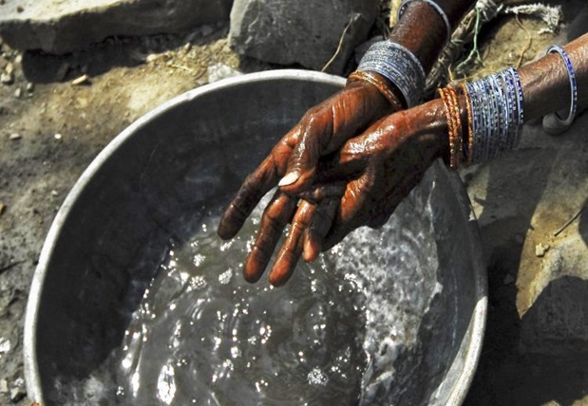
Precautions AFTER cleaning of sewer or Septic tanks
The employer shall ensure the following post-cleaning safety precautions after an person engaged in the cleaning of a sewer or a septic tank comes out of the sewer or septic tank after a session of cleaning:-
Provide facilities for removal of contaminated clothing and for wash-up as well as cleaning, dry clothing.
(ii) Wash-up material shall include but not be limited to water, soaps, hand sanitizers and adequate and medically authenticated skin cream for applying on the body for post cleaning safety.

Slide 47
Precautions AFTER cleaning of sewer or Septic tanks
Before eating, remove soiled work clothes and eat in designated areas away from human waste and sewage
handling activity
Wash hands with soap and water immediately after handling human waste or sewage and before eating or drinking.
Do not touch your face, mouth, eyes, nose or open sores while handling human waste or sewage.
Keep closed cuts, sores and wounds while handling human waste or sewage

Slide 48
Regular Precautions
Regular medical check-up of sewage and septic tank workers include examination of respiratory organs, skin injuries, and other occupational diseases
Treatment to their injuries to ensure that sewage workers afflicted with such diseases or injuries do not enter sewers for cleaning
Regular vaccination against respiratory and skin diseases and other occupational diseases to which these workers are prone due to exposure to harmful substances and gases in sewers.
1st , 2nd and booster dose of Covid – 19 vaccine should be administered to all sewage and septic workers
Training at every two years- On operations and maintenance of equipment used by SSW and safety measures practiced while working.

Slide 49
Protective gear and safety devices
For cleaning of SEWER AND SEPTIC TANK
22

Slide 50
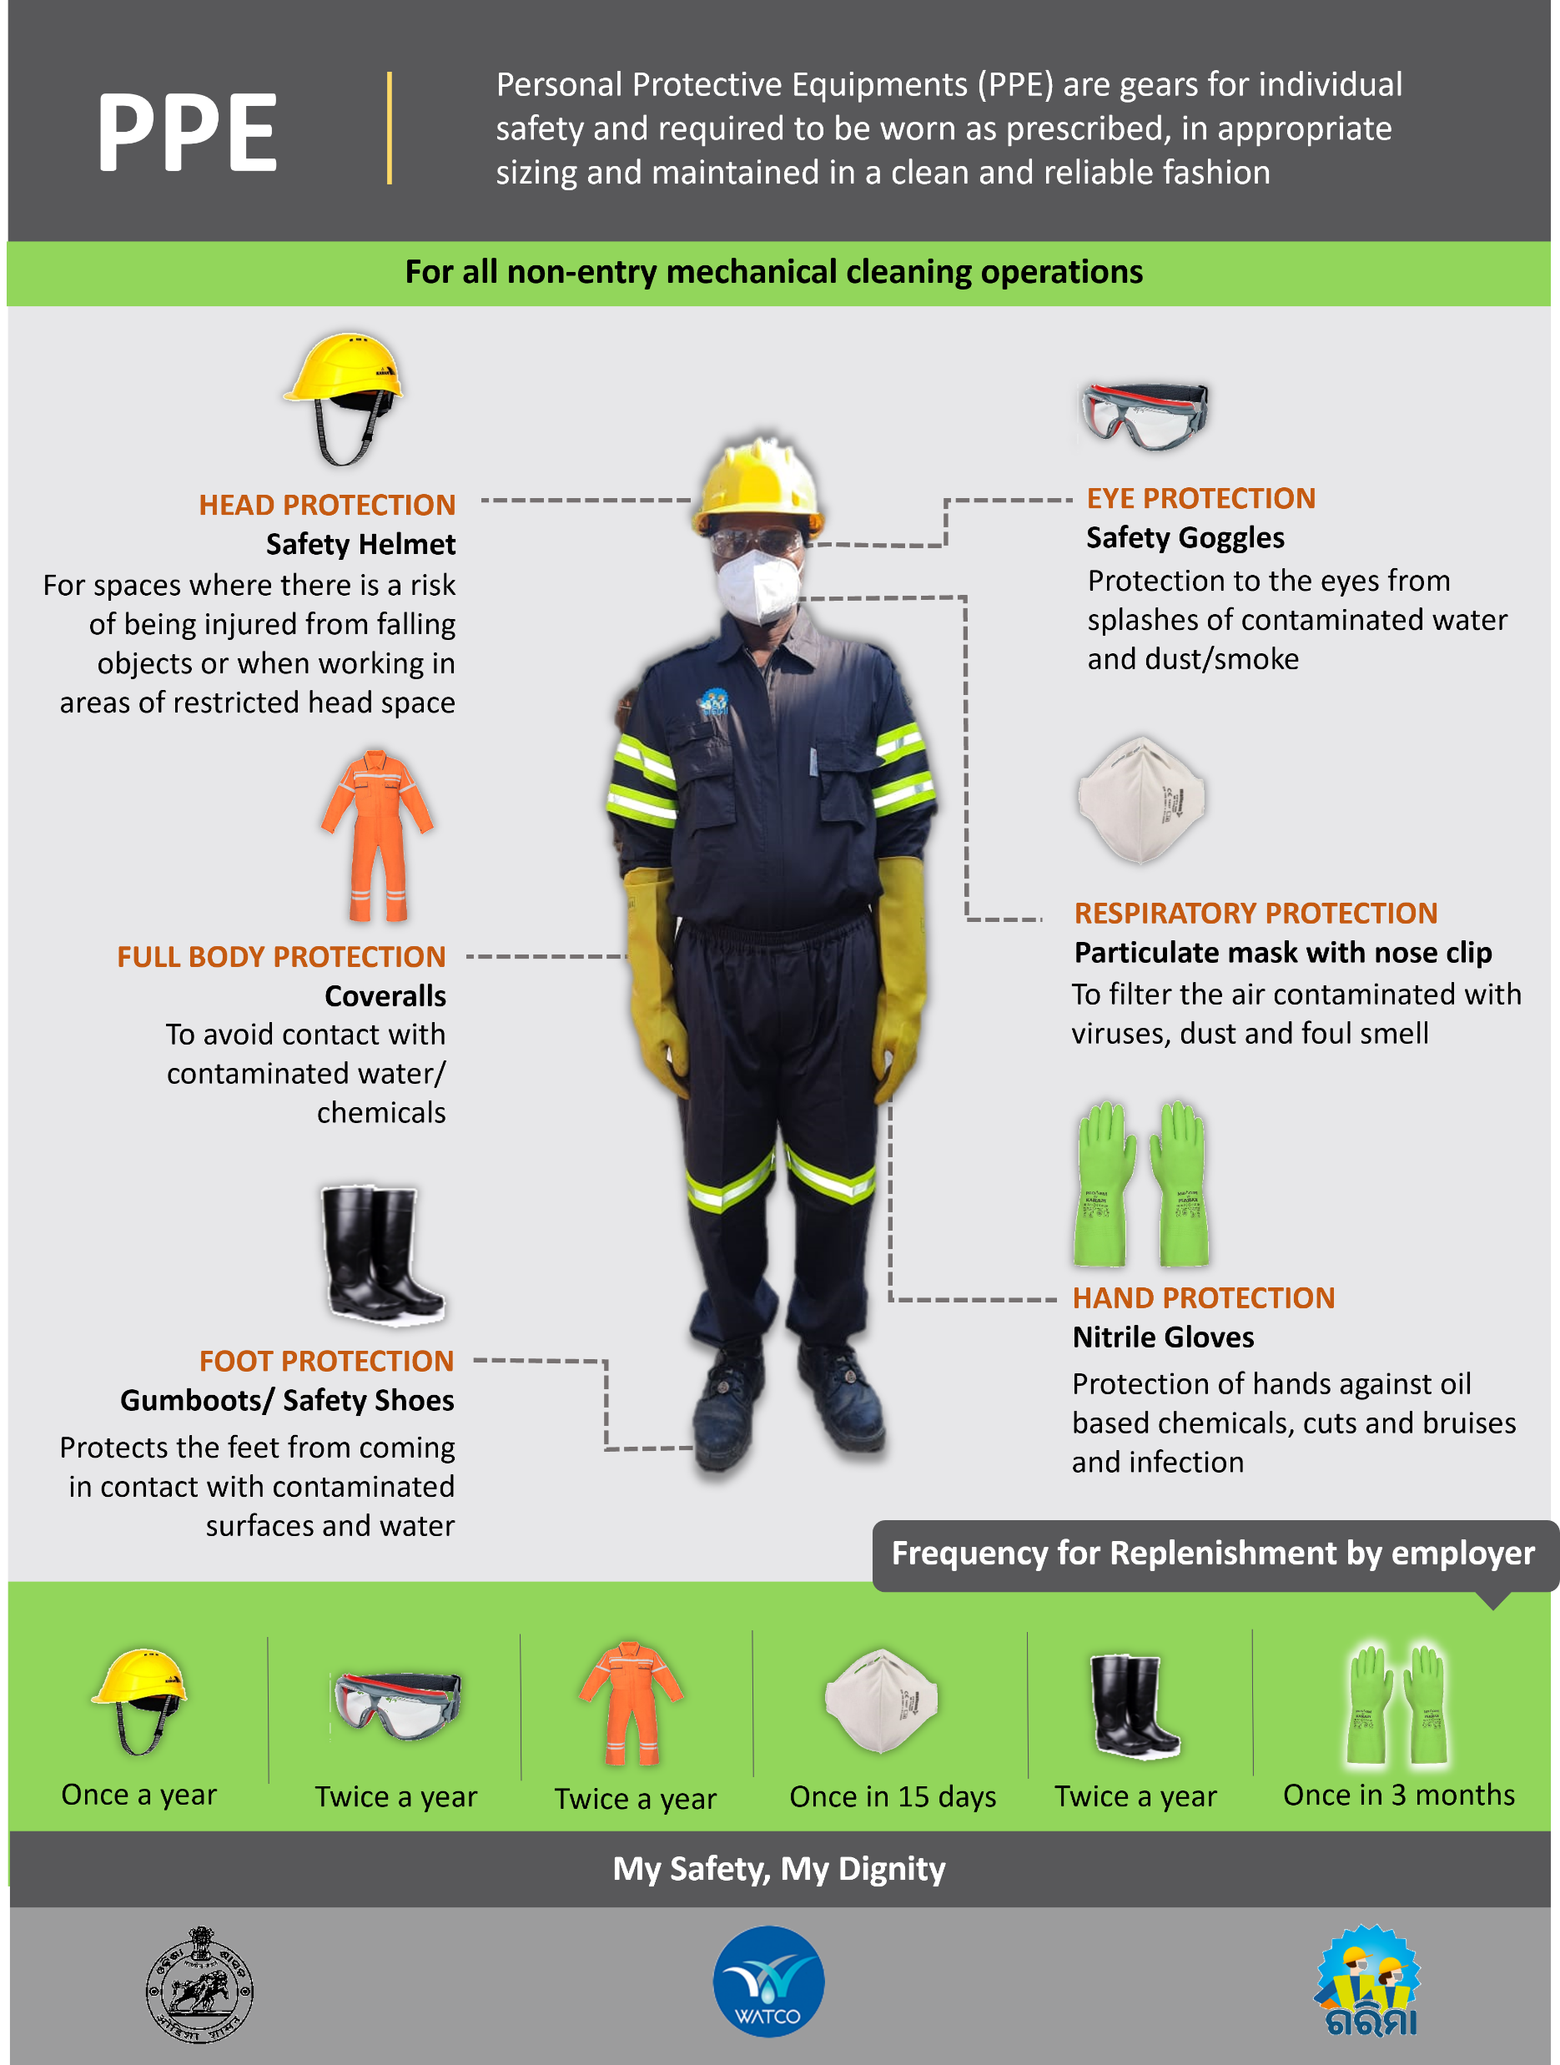
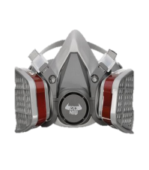
PPE for Sewer & Septic Tank Workers

Slide 51
PPE for Sewer & Septic Tank Workers
Helmet with Airvent
Jacket
Nitrile Gloves
Goggles
Gumboot
N95 Mask
Gas Mask with filter
Full Body Suit (Coverall)

Slide 52
Safety Devices for Manual Cleaning of Sewer/Septic Tank

Slide 53
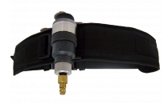
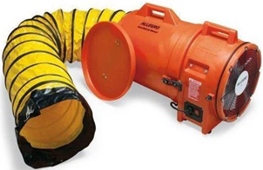
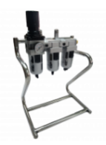
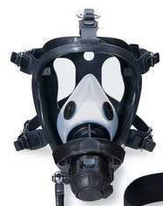
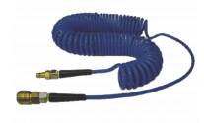
Safety Devices
Airline Respiratory with
Compressor
Gas Detector
Axial Fan Blowers
Safety Tripod set
Body harness
Provides oxygen supply to workers in confined area
Provides portable, safe overhead anchorage in large confined areas like machine holes, storage tanks
Fall protection and rescue in confined spaces
Detects toxic gases in confined spaces and environments
Cleans the air in confined space

Slide 54
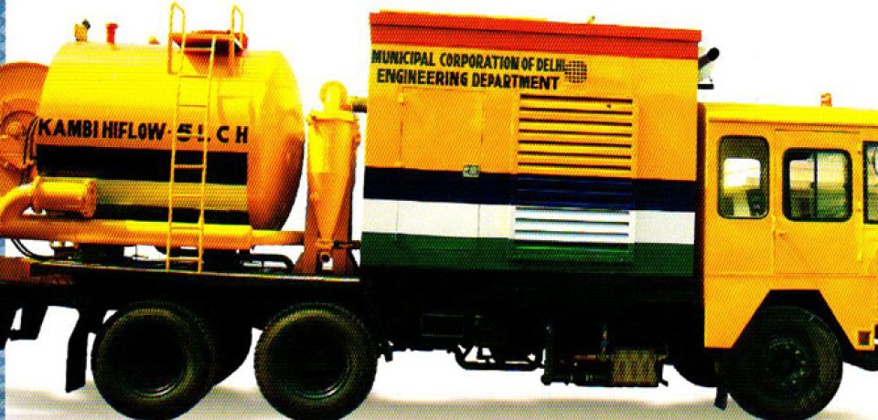
Desludging
of SEWER AND SEPTIC TANKS
60

Slide 55
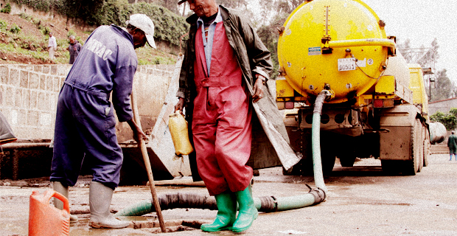
What is Desludging?
Sludge: Thick, soft, wet mud or a similar viscous mixture of liquid and solid components, especially the product of an industrial or refining process, human excreta.
Desludging: It is the process of removing sediments (Sludge) by draining and cleaning a tank.

Slide 56
Measures of health hazards for desludging operator/emptier
Workers must be trained to recognize potential hazards, use proper work practices and procedures, recognize adverse health effects, understand the physical signs and reactions related to exposures, and are familiar with appropriate emergency evacuation procedures
Ensure that tank covers have been kept open for atleast few hours
In case there are no covers and the tank is permanently covered by a slab of stone/cement, you will need appropriate tools to break the slab
Work clothing should be removed after work is finished and washed; workers should not return home in their work clothing as it may contaminate their home.
Presence of First Aid box at the site of desludging

Slide 57
Local authority is responsible for cleaning of septic tanks:
It is the responsibility of local authorthrity to facilitate cleaning of septic tanks.
House owners/users should contact the CEO of municipality/gram panchayat for cleaning of septic tanks.
In case they do not make arrangements for cleaning of septic tank they can make complaint in this regard.
A provision has been made in the feedback/grievance link on the website of NSKFDC i.e. www.nskfdc.nic.in for receiving complaints. National Commission for Safai Karamcharis’s website www.ncsk.nic.in also has provision for giving complaints.

Slide 58
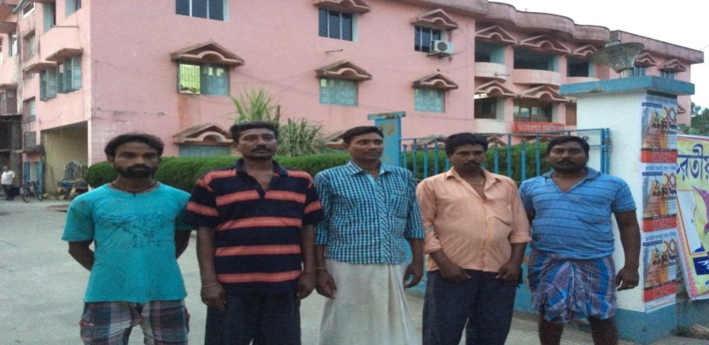
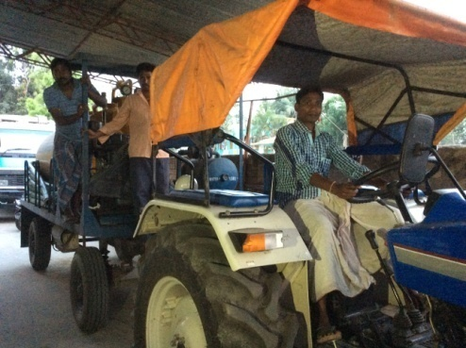
Success Story – TAHERPUR(NADIA) MODEL in centralized cleaning of septic Tanks
SUY Loan of Rs 14 lakhs for Cesspool with 3,000 Ltr tank to group of sanitation workers with tripartite agreement among SHG, Municipality and the State Channelising Agency (Funding agency)
Taherpur Municipality, Distt. Nadia, West Bengal informed the citizens that all cleaning of septic tank would be done through Municipality only
Municipality has an Enquiry to note the requisitions of the public for cleaning of Septic Tank
It takes advance of the estimated expenditure for emptying septic tank, from the household
Municipality has pool of Cesspool Vehicles and allots duty by roster to their owners (SHG), Cesspool does the cleaning and reports at the Enquiry
At fixed periodicity , Municipality distributes the total fund received which are used for Depreciation, EMI of loan . Service charge of Municipality, Payment to SHG as net income

Slide 59
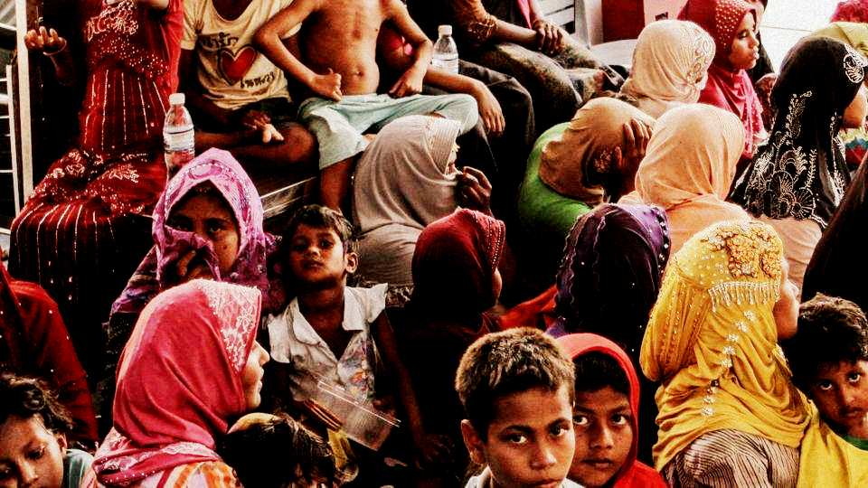
Schemes
For Rehabilitation of Manual Scavengers

Slide 60
Self-Employment Scheme for Rehabilitation of
Manual Scavengers
A. The following assistance is provided
One Time Cash Assistance of Rs. 40,000/- for enabling change in livelihood
Skill Development Training upto two years with stipend Rs. 3,000/-P.M.
Concessional Loan for self employment project upto Rs.15 lakh with capital subsidy upto Rs.5.00 lakh
Skilling and financing available to all dependents of the Manual Scavengers

Slide 61
Other Schemes
B. Under Centrally Sponsored Scheme of ‘Pre-Matric Scholarships:
Rs.225 per month is provided to day-scholars
Rs.700 per month to hostellers
C. SC/BC get benefits under regular SC/BC schemes

Slide 62
Loan schemes of NSKFDC for it’s targe group
Sl. No. | Name of the scheme | Maximum Limit | Rate of interest to |  | Repayment period
 |  |  | CAs | Beneficiaries
1. | Mahila Samridhi Yojana (MSY) | Upto Rs.1,00,000/- | 1% p.a. | 4% p.a. | 3 years*
2 | Mahila Adhikarita Yojana (MAY) | Upto Rs.2.00 lac | 2% p.a. | 5% p.a. | 5 years *
3 | Micro Credit Finance (MCF) | Upto Rs.1,00,000/- | 2% p.a. | 5% p.a. | 3 years*
4 | General Term Loan (GTL) | Upto Rs.15.00 lacs | 3% p.a. | 6% p.a. | 10 years*
5 | Education loan (EL) -For study in India -For study abroad [The interest on Education Loan (for study in India) is reimbursable under the scheme of Ministry of Human Resource Development Government of India to the beneficiaries whose family annual income is upto 4.50 lac per annum] | Upto Rs.10.00 lacs Upto Rs.20.00 lacs | 1% p.a. | 4% p.a.# | 5 years after co-termination of course with moratorium period of one year.

Slide 63
Swachhta Udyami Yojna (SUY)
The objective of the SUY scheme is to prevent manual hazardous cleaning and to promote mechanised cleaning.
NSKFDC under its Swachhta Udyami Yojana (SUY) provides financial assistance for procurement and operation of sanitation related equipments/vehicles with a view to promote mechanised cleaning. Three broad implementation models of SUY are as under:
Target Group
Loans for mechanised cleaning equipments vehicles costing upto Rs.15.00 lacs for individuals/ upto Rs. 50 Lakhs for group projects.
For Urban Local Bodies (ULBs)
Direct loans to ULBs for mechanised cleaning equipments costing upto Rs.50.00 lacs per unit (No. of units could be more than 1).
Private Agencies/ Contractors
Loans for procurement of mechanised cleaning equipments costing upto Rs.50.00 lacs per unit (No. of units could be more than 1).
4% rate of interest with upto 7 years repayment period.
1% interest rebate for women and 0.5% for timely repayment.
Provision of Capital Subsidy upto Rs.5.00 lacs per unit.
4% rate of interest with 1% rebate for timely repayment.
Repayment period of up to 7 years.
6% rate of interest with 1% rebate for timely repayment.
Repayment period of up to 7 years.

Slide 64
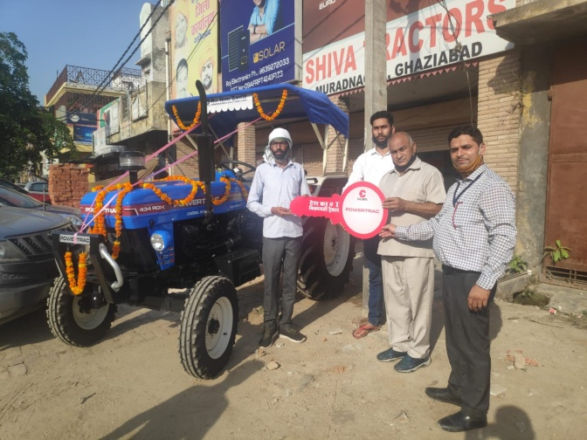
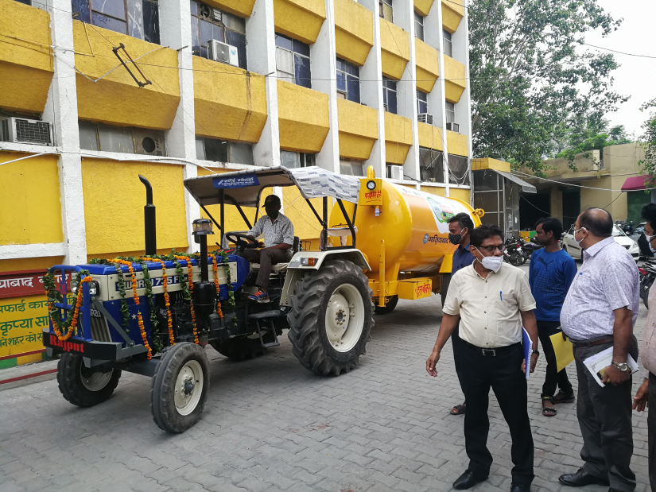
Swachhta Udyami Yojna (SUY)
Eligibility: Identified Manual
Scavengers, Sanitation Workers
and their dependants.
Capital subsidy:
50% of project cost
Projects up to Rs. 5.00 lakh
Projects between Rs. 5.00 lakh to Rs. 15.00 lakh
Rs. 2.50 lakh + 25% of the remaining project cost between Rs. 5.00 lakh to Rs. 15.00 lakh
64

Slide 65
Capital Subsidy for Group Project
Maximum Project Cost
upto Rs.50.00 lakh
Maximum project share per beneficiary
Rs.10.00 lakh per beneficiary
Rs.3.75 lakh.
(Rs. 2.50 lakh for project cost upto Rs. 5.00 lakh + 25% of remaining project cost)
Maximum capital subsidy per beneficiary
65

Slide 66
Interest Subsidy
Rate of Interest
6% p.a.
Interest subsidy
For rate of interest charged by bank over and above 6%
Repayment Period
Up to 7 years, including moratorium period up to 6 months
66

Slide 67
Process of Swachhta Udyami Yojna (SUY)
Scope of providing regular mechanised cleaning work to the Sanitation workers/dependents
Nomination of sanitation workers as beneficiaries by providing them long term work assurance for mechanised cleaning
Facilitation of loans by ULBs resulting in sanction of loan by the Banks
Banks claim Capital Subsidy from NSKFDC and disburse the total funds (including Loan & Capital Subsidy) for procurement of equipments/vehicles
Procurement of equipments/vehicles by the beneficiaries and commencement of work in coordination with the ULBs
Regular repayment of Loans by the beneficiaries

Slide 68
Expectations from ULBs in SUY Scheme
Assessment of sewer septic tank cleaning process and need for deployment of additional equipments/vehicles and related funds to ensure complete mechanization of the process.
Nominating Safai Karamcharis/Dependents from ULB as the beneficiary of the scheme for taking up related Sanitation Enterprise.
Providing long term and assured mechanized cleaning work contract to the target group of NSKFDC and their inclusion in the panel of approved service providers by providing WORK ASSURANCE LETTER.
Support in Liasoning with banker/channel agency of NSKFDC for provision of loan to the beneficiaries. A Letter of Assurance regarding assured work may be provided to the banker.
Arrangement to deduct the EMI and remit the same to the Bank from the payments due to the applicant by the Municipality to boost confidence of banker in lending to them

Slide 69
Swachchhta Udyami Yojana (SUY) Loan to Contractors for purchase of sanitation related machines/equipments
Concessional loan at 6% p.a. to contractors having contracts for sanitation related work from municipalities and other Sanitation related local bodies.
90% loan on machines costing upto Rs. 50 lakh to be repaid in 7 years.
Loan to be provided through State Channelising Agencies and partner Banks of NSKFDC (Bank of Baroda, Canara Bank, IOB and RRBs)
Skill Council for Green Jobs

Slide 70
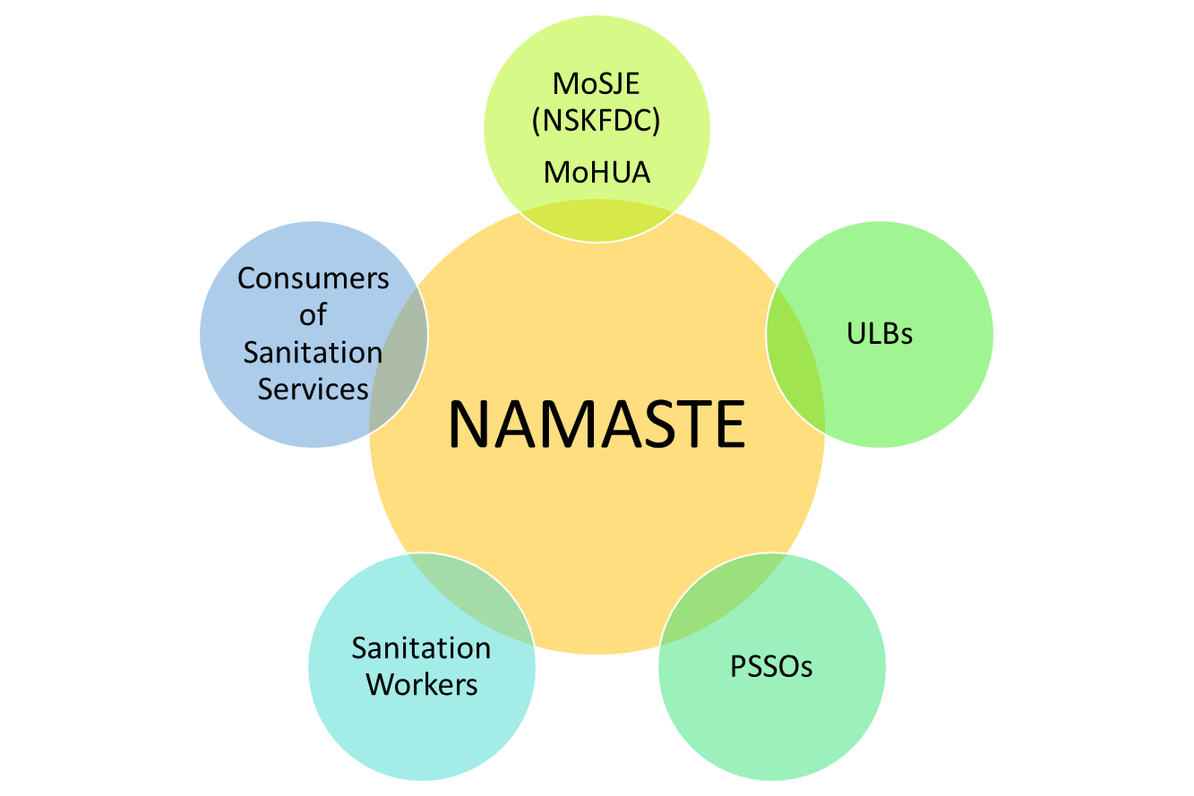
“National Action for Mechanised Sanitation Ecosystem” (NAMASTE)
( a joint initiative of MoSJE, MoHUA, DoDWS and DPIIT)
1
2
3
4
100 % Mechanization of cleaning operation of sewer and septic tanks
Zero fatalities and zero tolerance towards hazardous cleaning
Capacity Building of Safai Mitras through occupational training, provision of safety Kits/Devices
Creating awareness through IEC campaigns which are operator/ citizen/Safai Mitras centric and holding of workshops in all ULBs
Objective
Stakeholders
Target Group:
SSWs
Septic Tank Cleaners
Sewer Line Cleaners
70

Slide 71
Need for NAMASTE
Under Section 33 of the MS Act, 2013:
Duty of local authority etc. to use appropriate technological appliances for cleaning of sewers, septic tanks to eliminate the need for the manual handling of excreta in the process of their cleaning.
Government to promote, through financial assistance, incentives and otherwise, the use of modern technology.
There is a need for full mechanisation of cleaning of sewers and septic tanks and rehabilitation of the sanitation workers engaged therein.
Majority of Sanitation workers do not get covered as part of current social protection
Sanitation workers are primarily engaged as informally, hired by contractors below minimum wages with no choice of alternative livelihood
Sanitation workers have limited access to existing social protection framework or unable to address basic needs of workers
Sanitation workers engage in manual work with limited or no safety gear or mechanised equipment
No Programme to identify such workers and focus on safety and dignity and assisting them with livelihood interventions
71

Slide 72
Interventions under NAMASTE through ULBs
Scheme is proposed to be implemented during next three years from 2023-24 to 2025-26 with an expenditure of 350.00 cr.
Profiling of Sewer/Septic Tanks cleaning workers and their family.
Appointment of RSA in every Districts.
Constitution of ESRU in larger ULB of Districts to cover Urban and Rural areas having:
Helpline number (14420)
Well trained, motivated and appropriately equipped manpower
Requisite equipments for cleaning
Safety Kits: Distribution of safety PPE kits to SSWs
Safety Equipments: Providing safety equipments to SRUs.
IEC Campaign: Targeting Safai Mitras, Operators/Contractors, Citizens through RWAs by organizing workshop/webinar.
Health Insurance coverage under Ayushman Bharat (after profiling by ULBs)
IT Enabled MIS: A comprehensive and robust IT enabled NAMASTE MIS would be established for implementation, tracking of targets and achievements etc.
Occupational Training: Provide occupational training
Assistance: Capital Subsidy upto Rs. 5.00 lakh and interest subsidy for projects financed by banks for sanitation related projects.
Evaluation: NAMASTE interventions to be evaluated under Swachchh Survekshan by MoHUA
72

Slide 73
Implementation of NAMASTE
Coordination Committee under the chairmanship of Secretary, MoSJE for regular monitoring of implementation.
MoHUA: To provide fund for mechanization and monitoring of desludging operation regularly.
NSKFDC will be CNA as well as implementing agency to provide:
Funds to ULBs
Occupational training
Subsidy to the beneficiaries
Sensitization camps for Safai Karmacharis, service seekers like citizen through RWAs, Hotels, Malls, Hospitals of the area.
Massive IEC Campaign targeting Safai Mitras, Operators/Contractors, Citizens through RWAs by organizing workshop/webinar
State Director of NAMASTE, Each State shall nominate SBM–Mission Director or any other officer to act as Director (NAMASTE)
District: Ensure appointment of RSA and establishment of SRU in each district.

Slide 74
Expectations from States in NAMASTE Scheme
Implementation of MS Act,2013
Implementation of provisions of MS Act, 2013 which prohibits hazardous cleaning of Sewer and Septic Tanks
Facilitate Institutional mechanisms to ensure zero fatalities
Appointment of Response Sanitation Authorities (RSAs) in all Districts
Setting up of Emergency Sanitation Response Units (ESRUs) in all Municipal Corporation and Districts to ensure safe sanitation service delivery and confined space entry as per MoHUA Advisory and MS Act,2013
Constitution of Helpline No. 14420 at ERSU to ensure receipt of the request for sewer septic tank cleaning.
Support to NSKFDC
Direct ULB’s to extend full cooperation and support to NSKFDC in the implementation of NAMASTE

Slide 75
Expectations from ULBs in NAMASTE Scheme
Nomination of a Nodal Officer for coordination with NSKFDC for implementation of NAMASTE
Profiling of SSW
Provide data on Sewer and Septic Tank workers at the ULB level
Mobilization of PSSOs at camp for profiling of SSW employed by them
Empanelment of PSSOs
Occupational Safety Training
Facilitate occupational safety training of sewer and septic tank professionals in the usage of PPE and safety gear & handling mechanized cleaning operations provided by NSKFDC
Linkage with Livelihood
Nominating SSW/Dependents from ULB as the beneficiary of the SUY scheme for linkage with a capital subsidy to procure sanitation-related machines
Provide long-term and assured mechanized cleaning work contract to SSW through required changes in the tendering process for empanelment of PSSO
Arrangement to deduct the EMI and remit the same to the Bank
Mobilization and handholding of SSW into SHG through linkage with NULM for Sanitation related enterprise
Nomination of Nodal Officer

Slide 76
Organization of Profiling Camp
Role of ULBs in conducting a Profiling Camp:
Compilation of list of Sewer and Septic Tank workers employed by ULB (contractual and on payroll) and SSW employed by all Private Service Sanitation Organizations at the ULB for profiling of SSW
Nomination of designated officials for camp management
Nominate officials for training on Survey app and for executing the digital survey
Mandatory attendance of ULB officials in the training of the survey app
Organize profiling camp after finalizing the date, venue and time of camp

